Slide 1
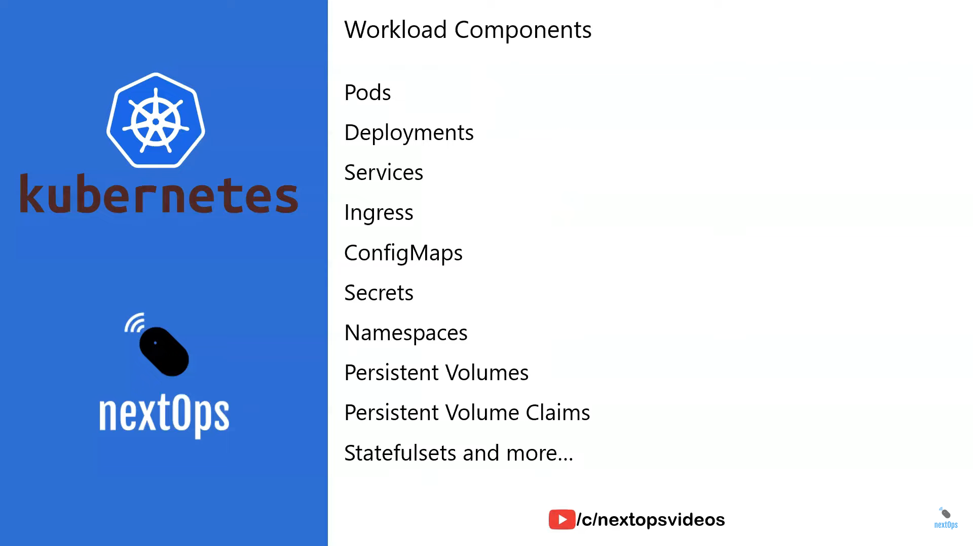

Slide 2
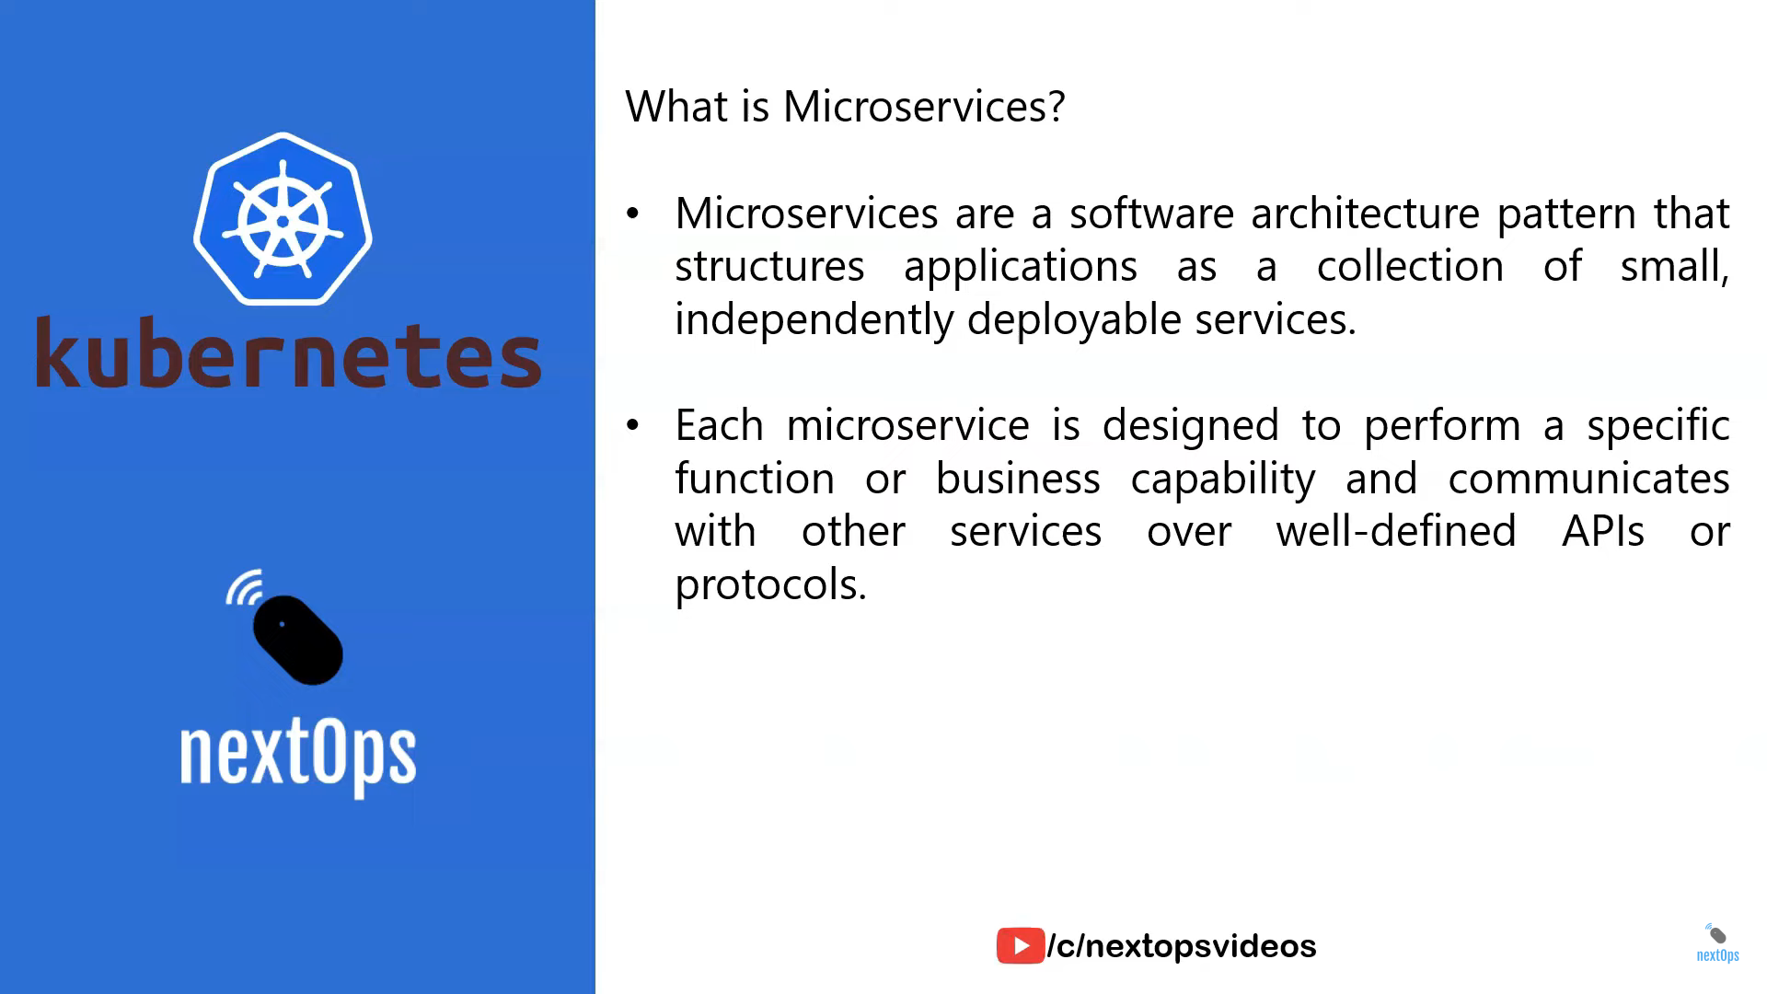

Slide 3
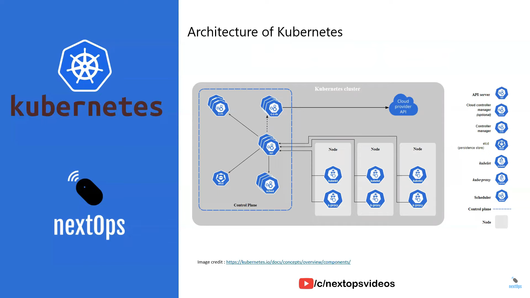

Slide 4
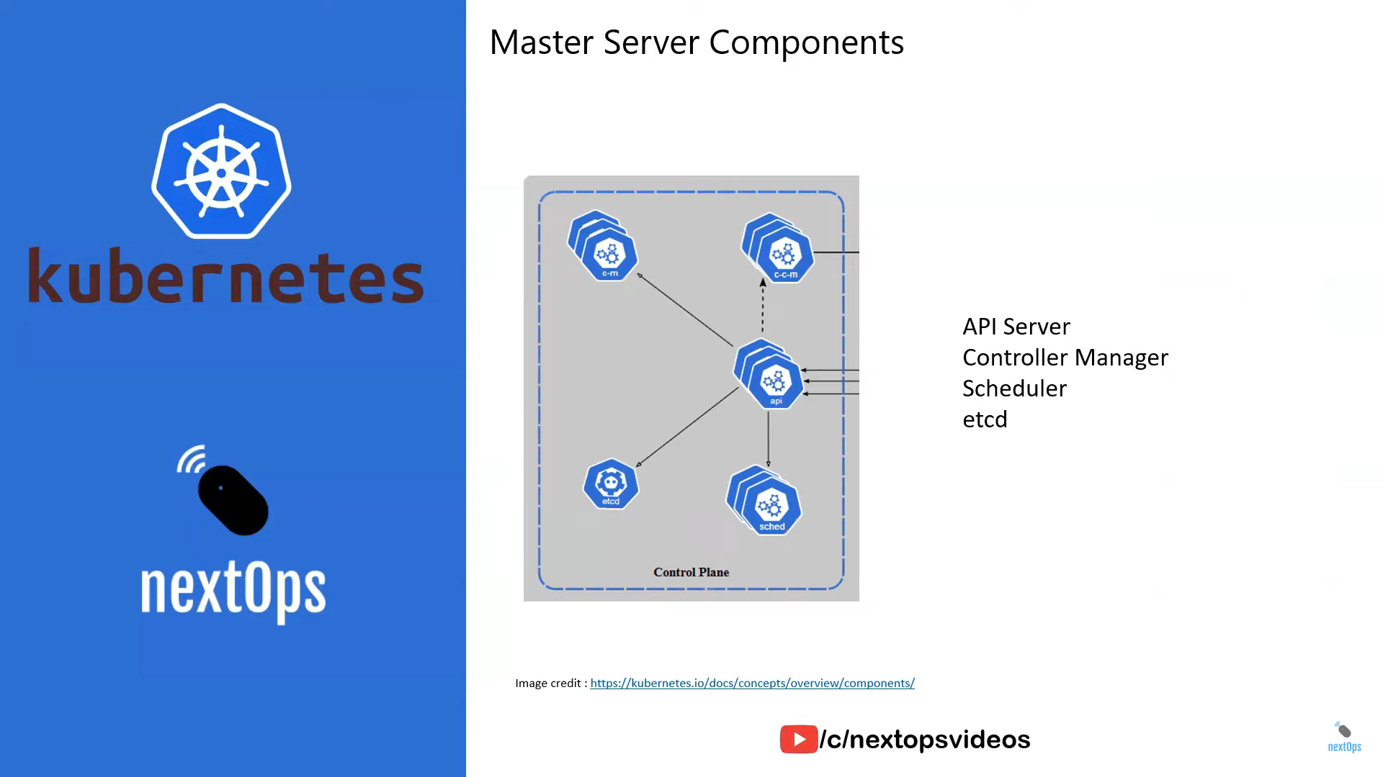

Slide 5
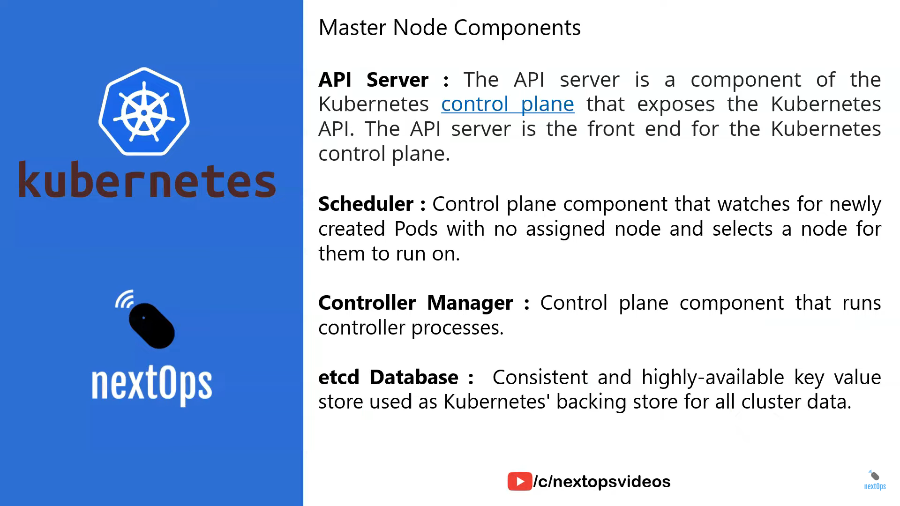

Slide 6
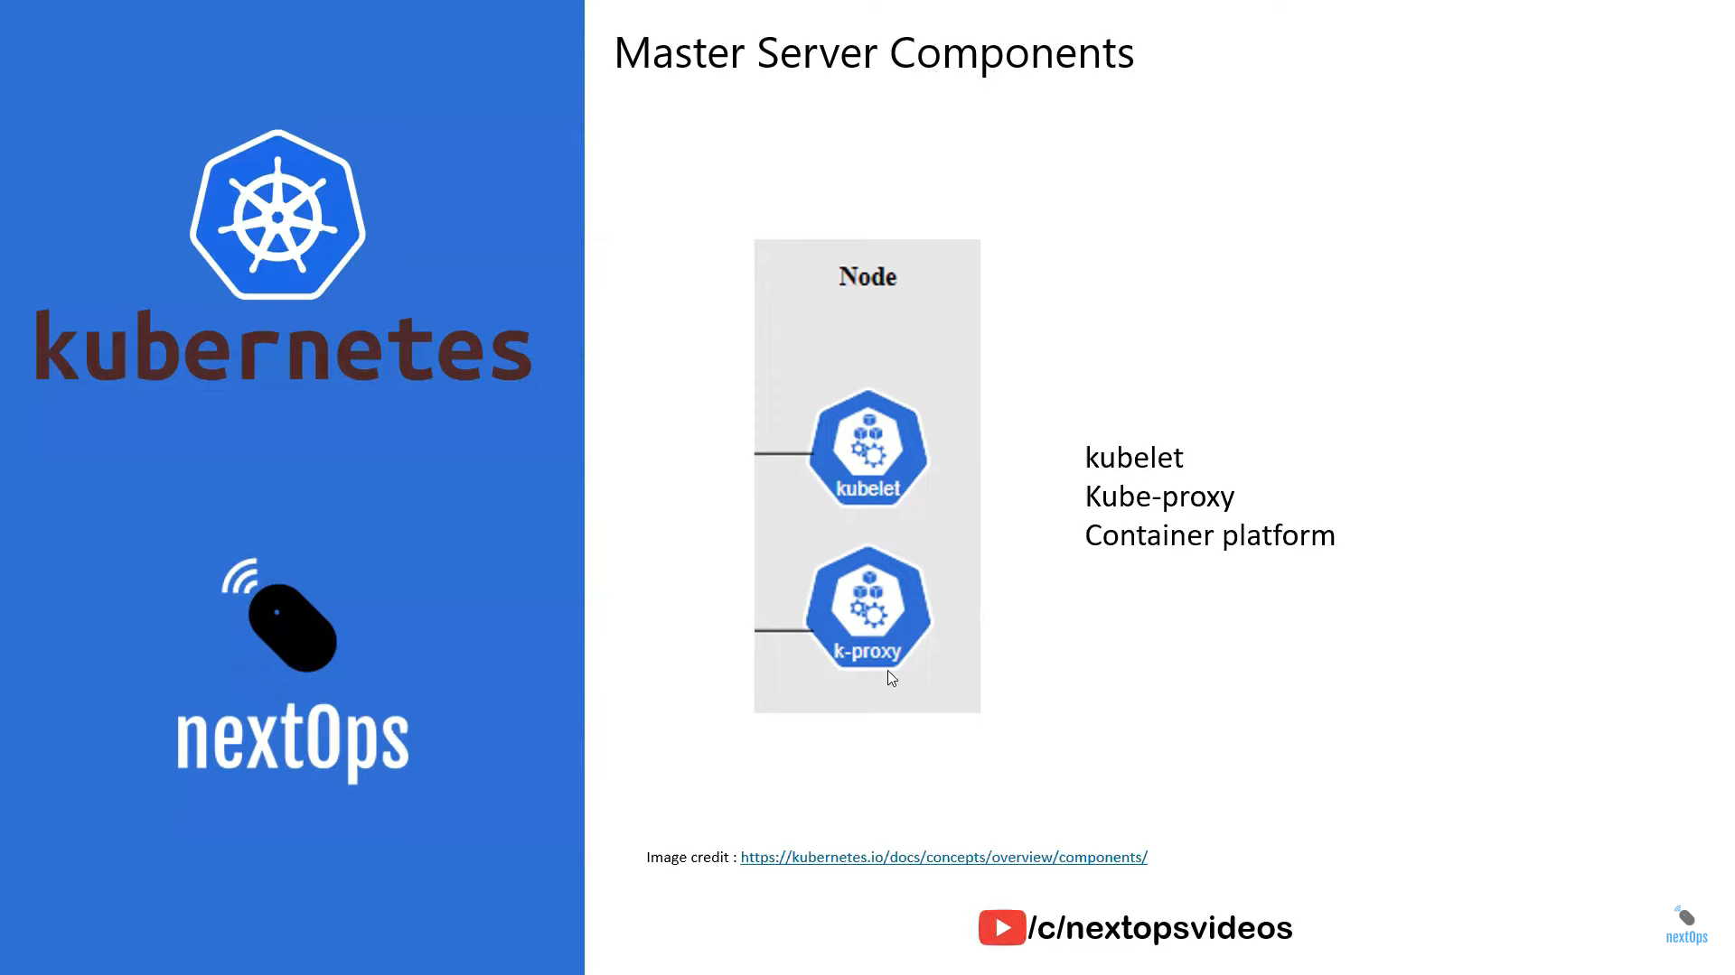

Slide 7
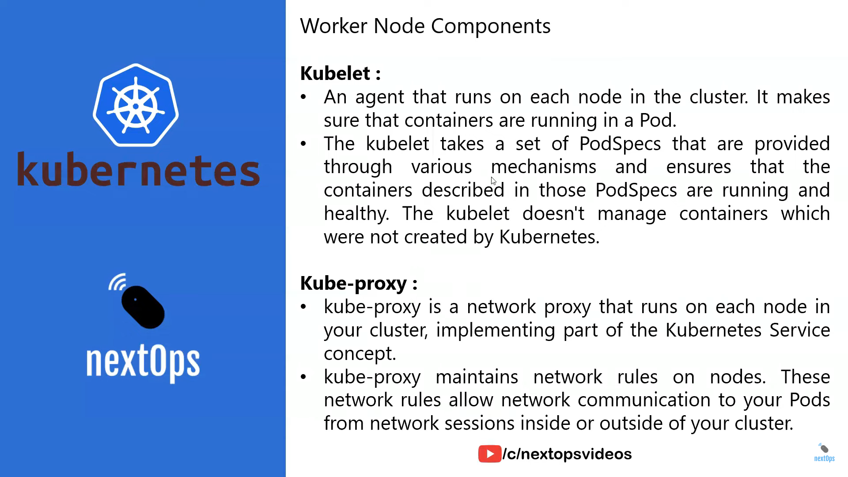

Slide 8
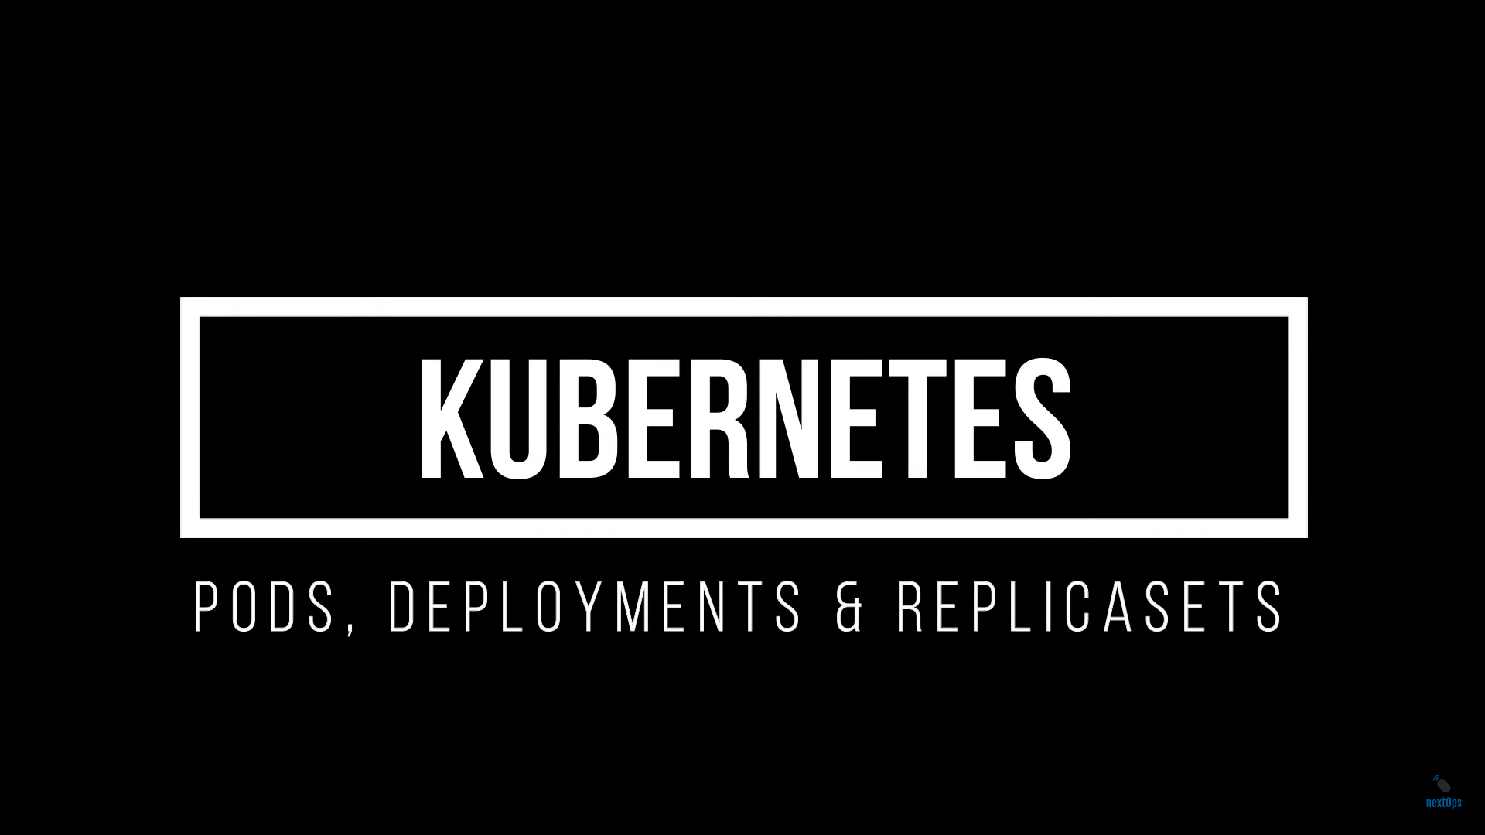

Slide 9
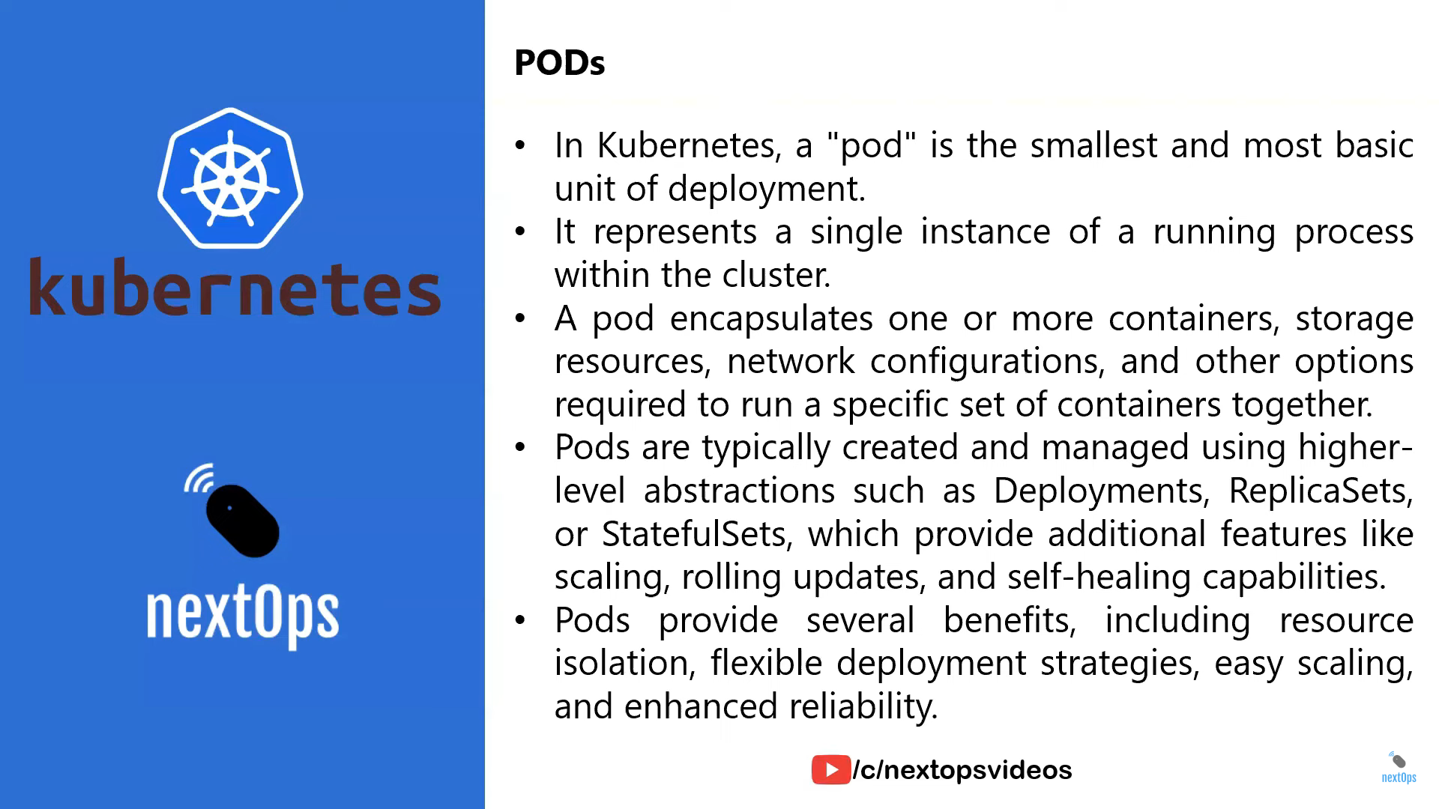

Slide 10
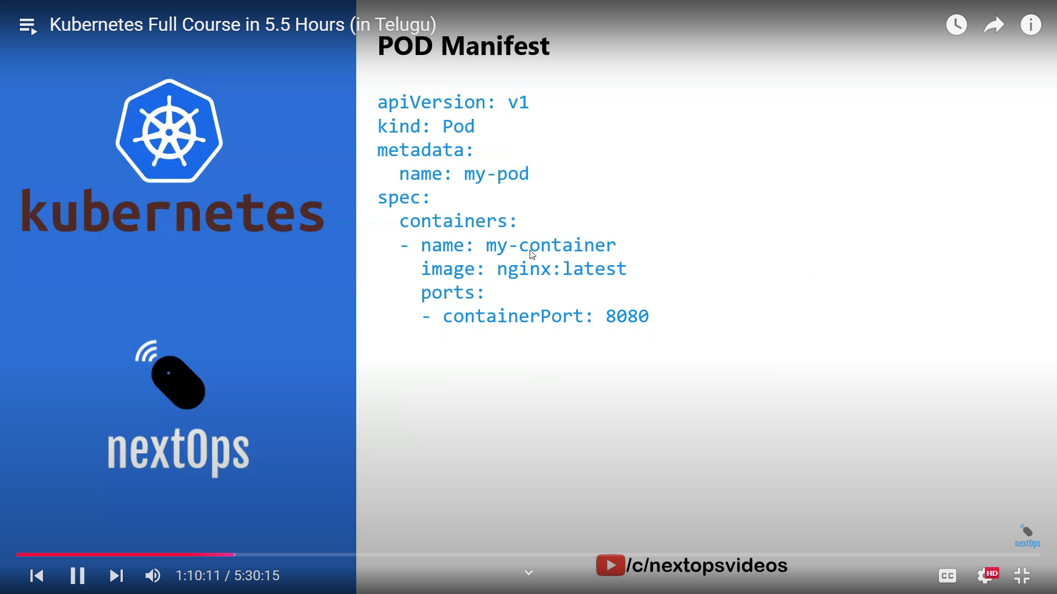

Slide 11
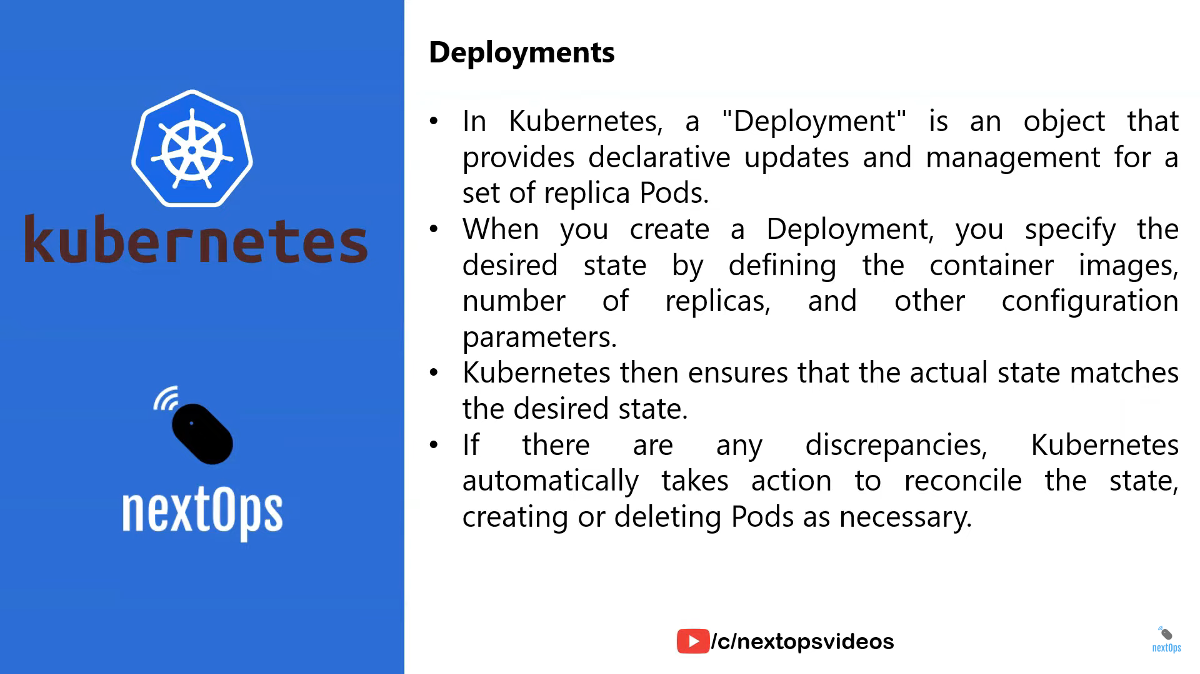

Slide 12
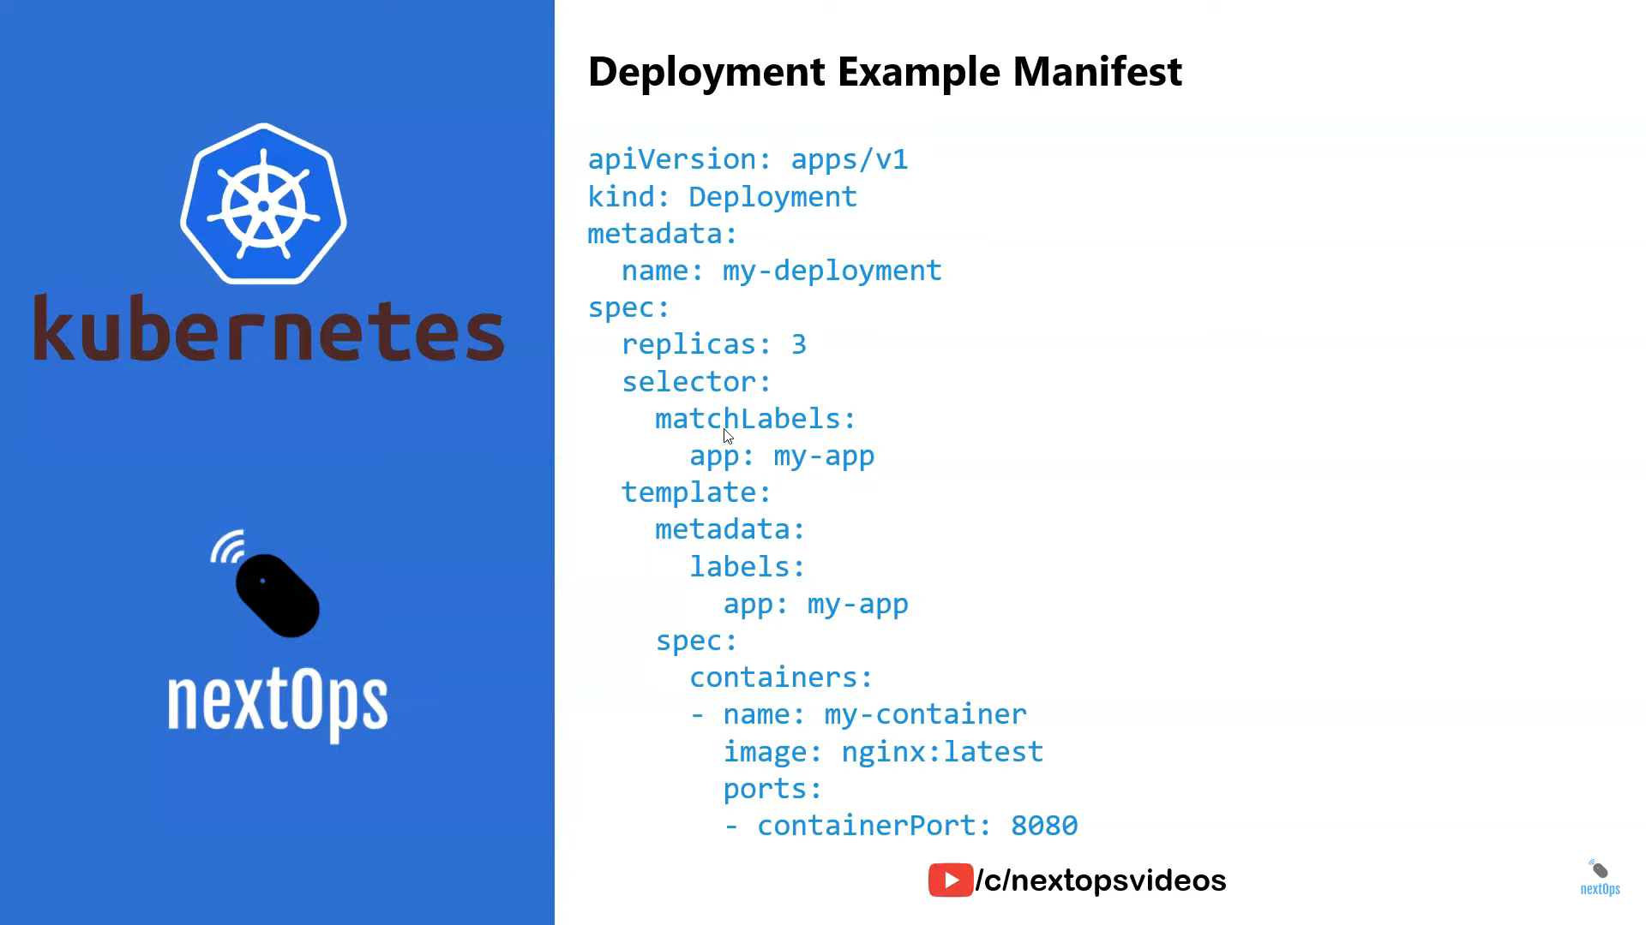

Slide 13
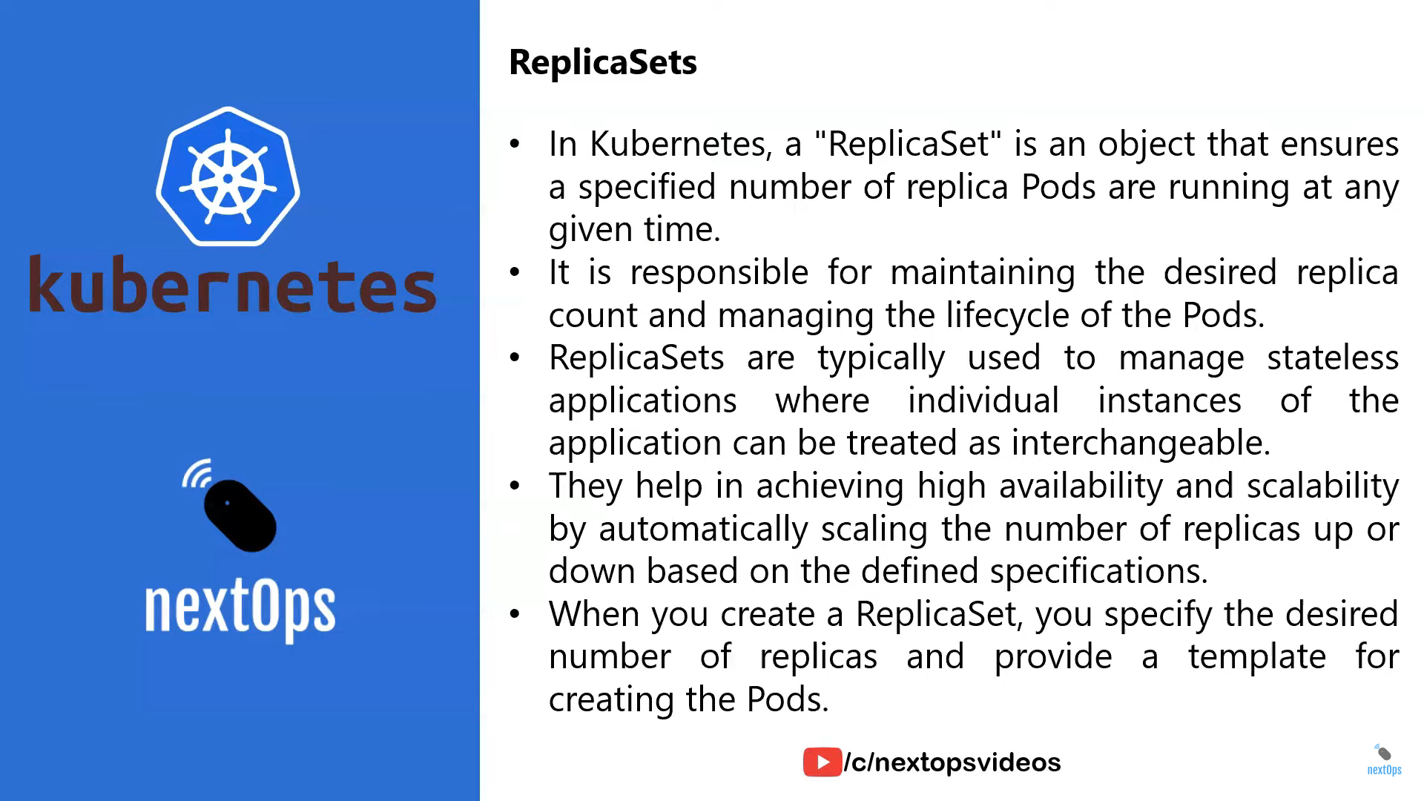

Slide 14


Slide 15
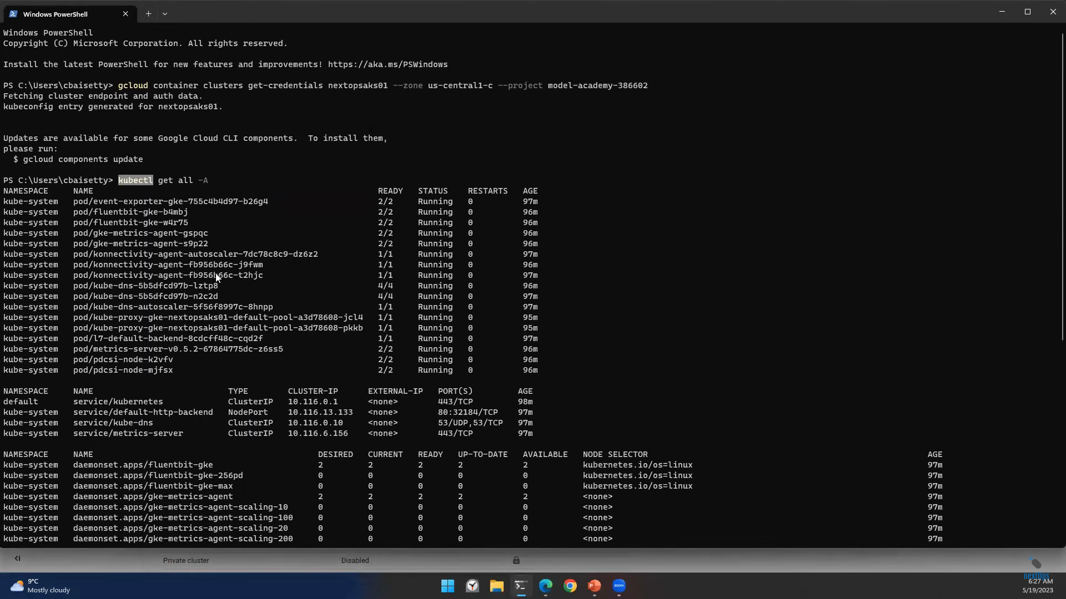

Slide 16
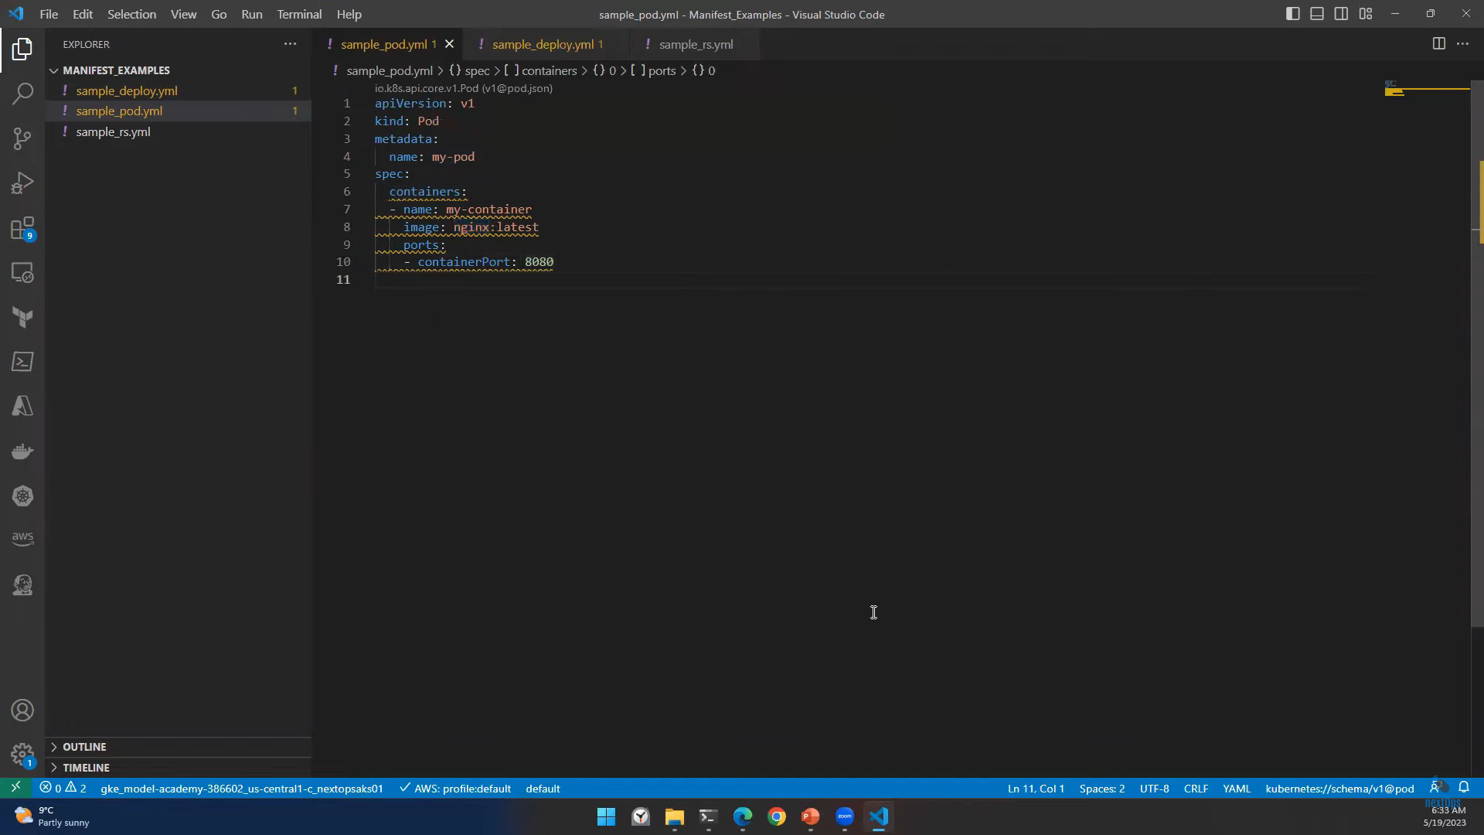

Slide 17
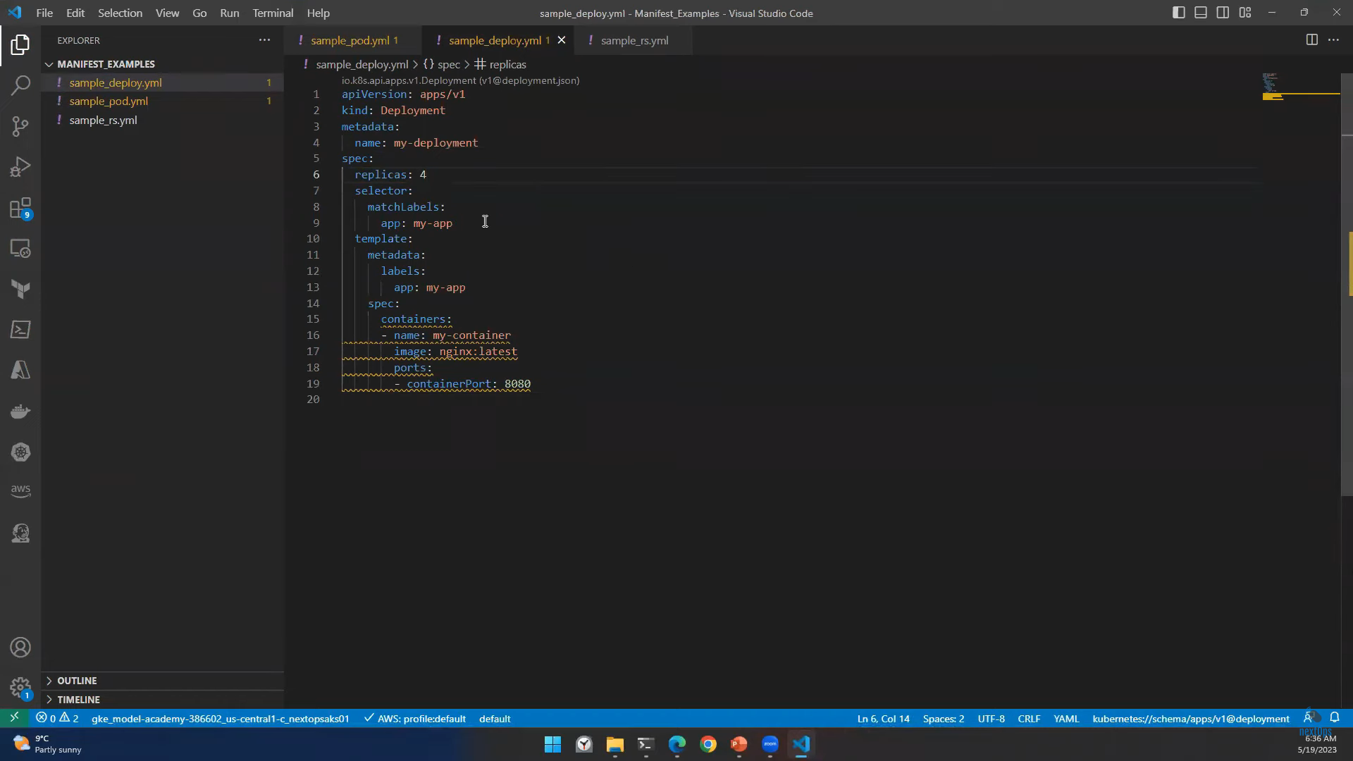

Slide 18
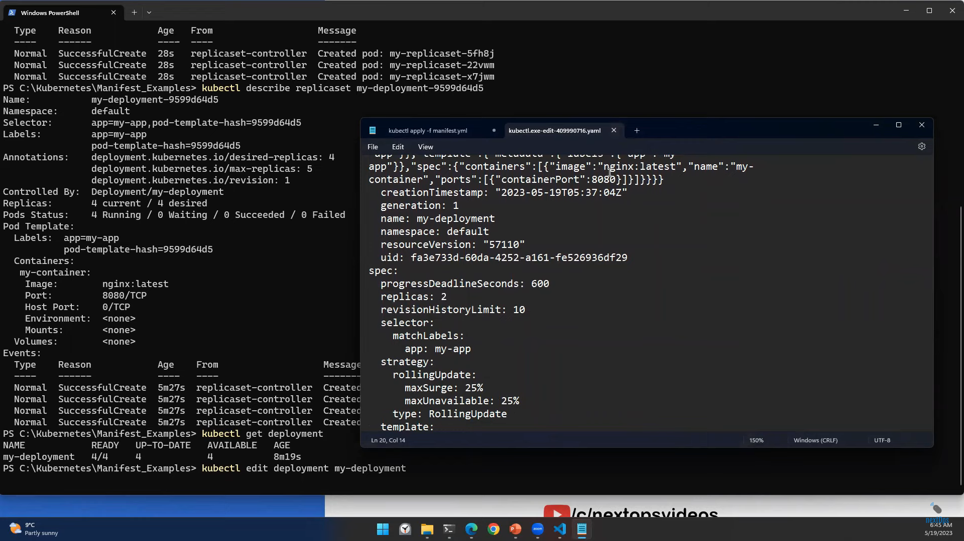

Slide 19
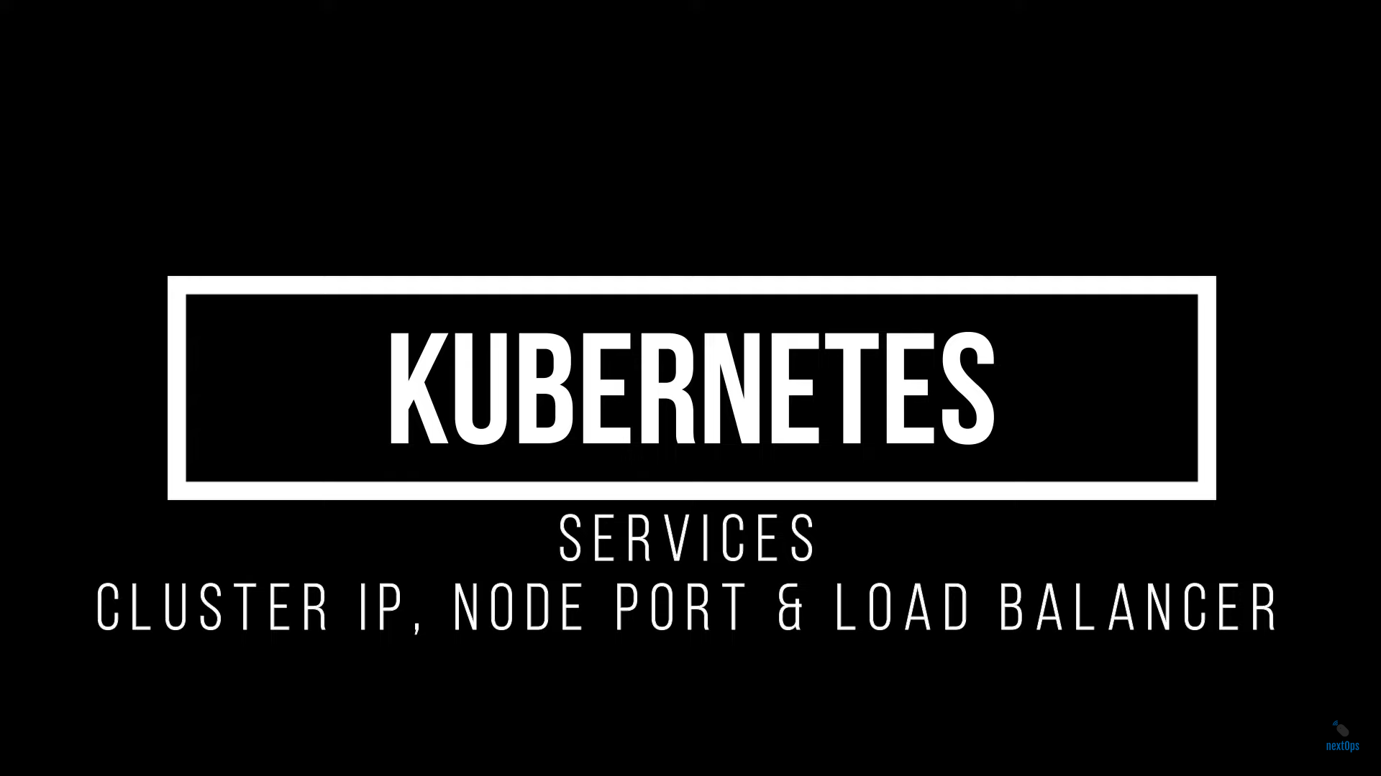

Slide 20
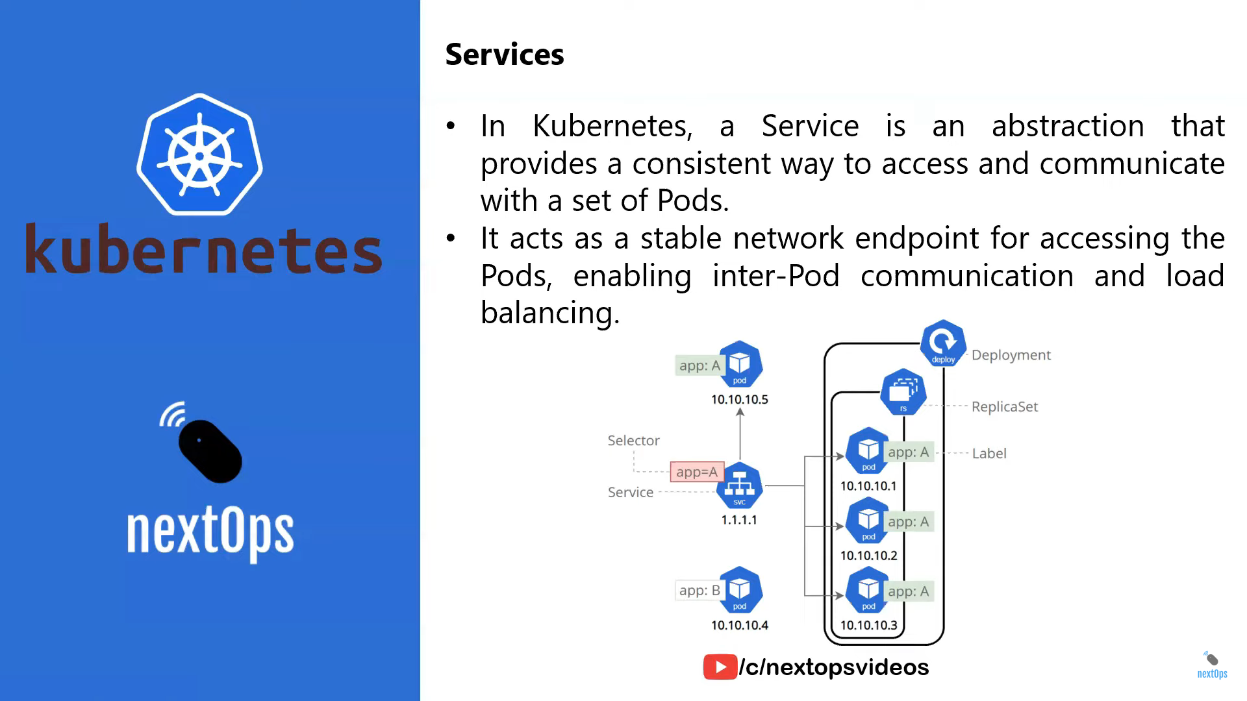

Slide 21
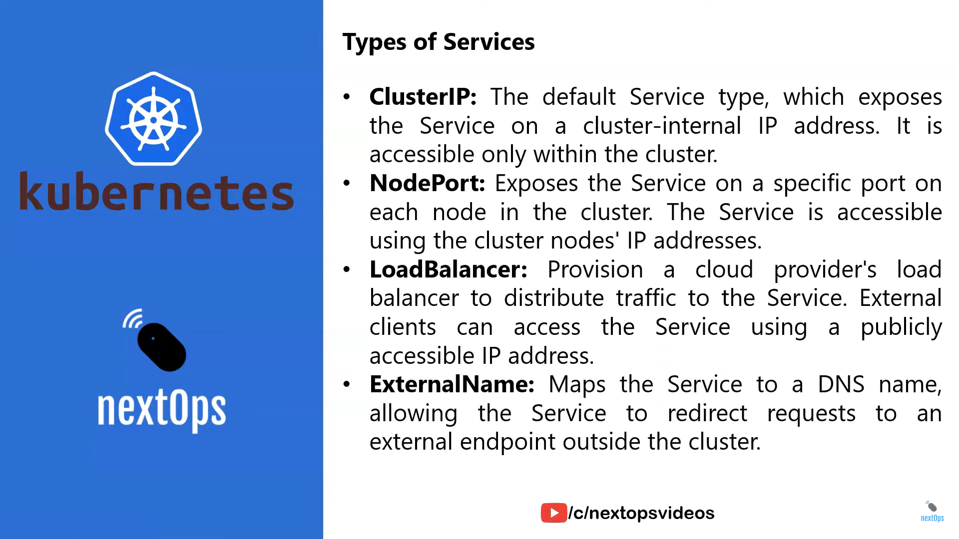

Slide 22
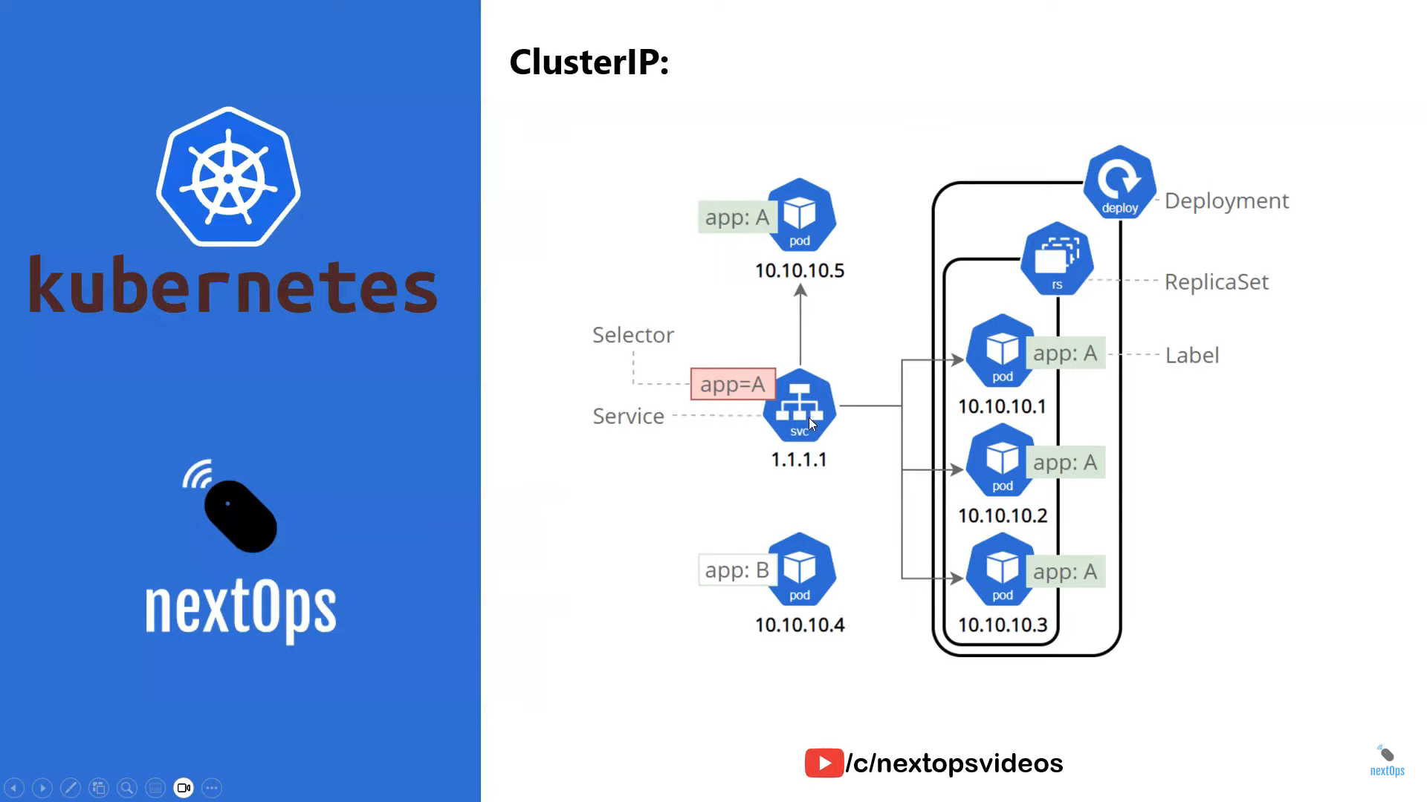

Slide 23
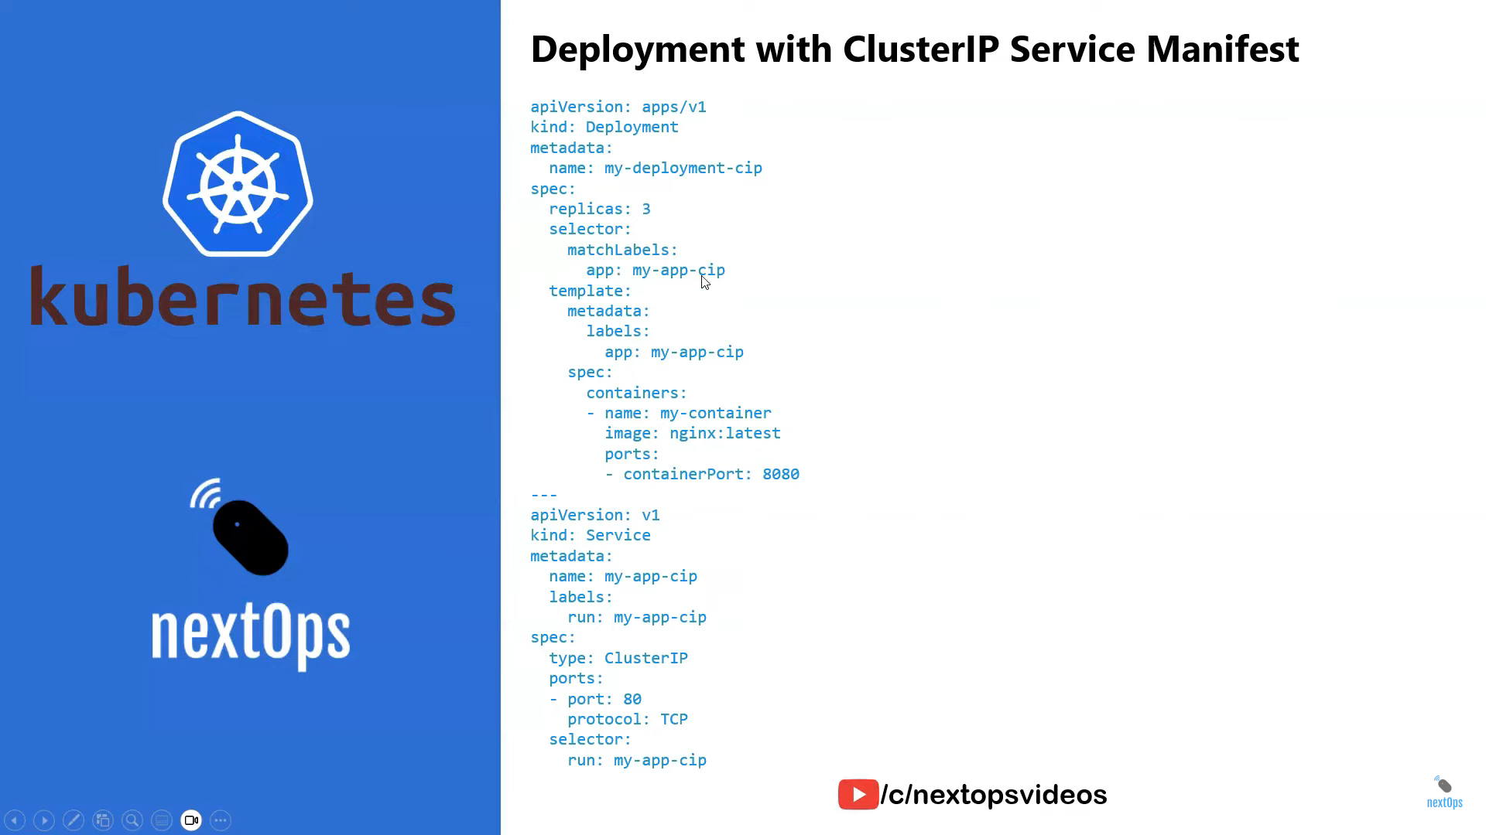

Slide 24
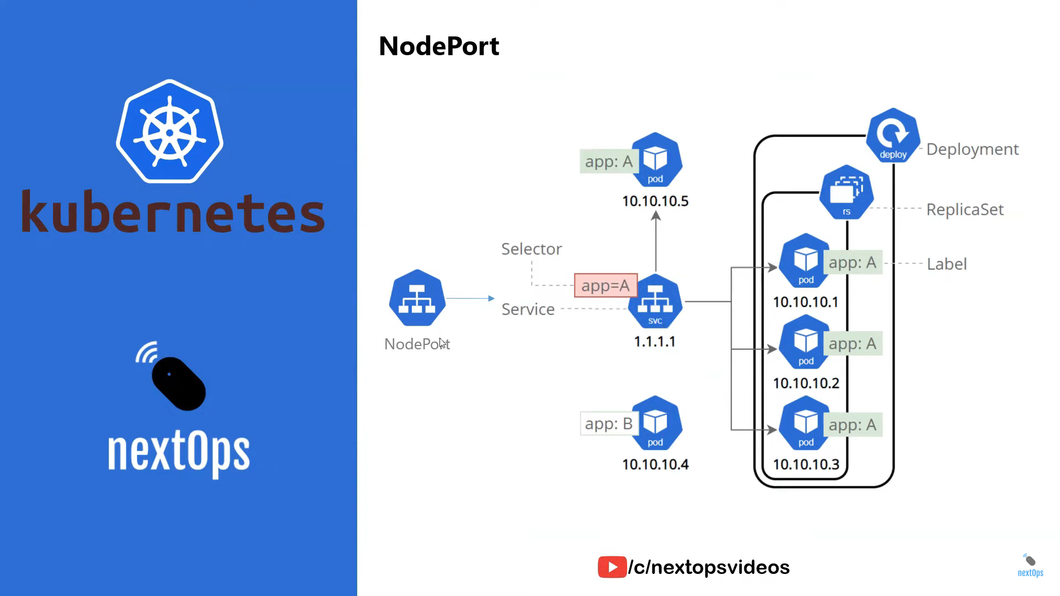

Slide 25
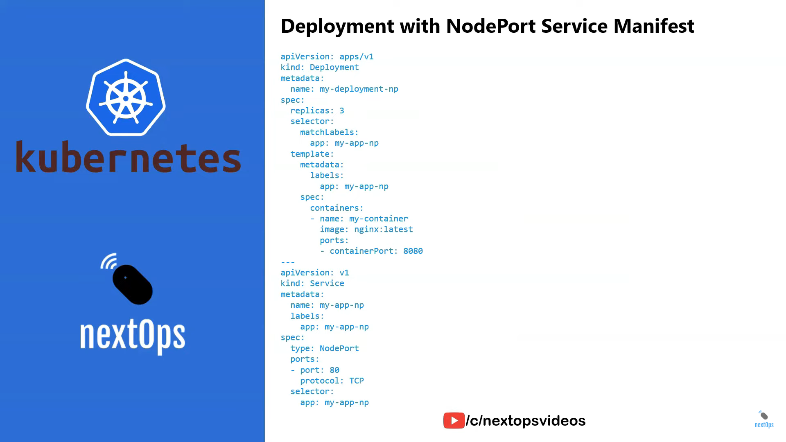

Slide 26
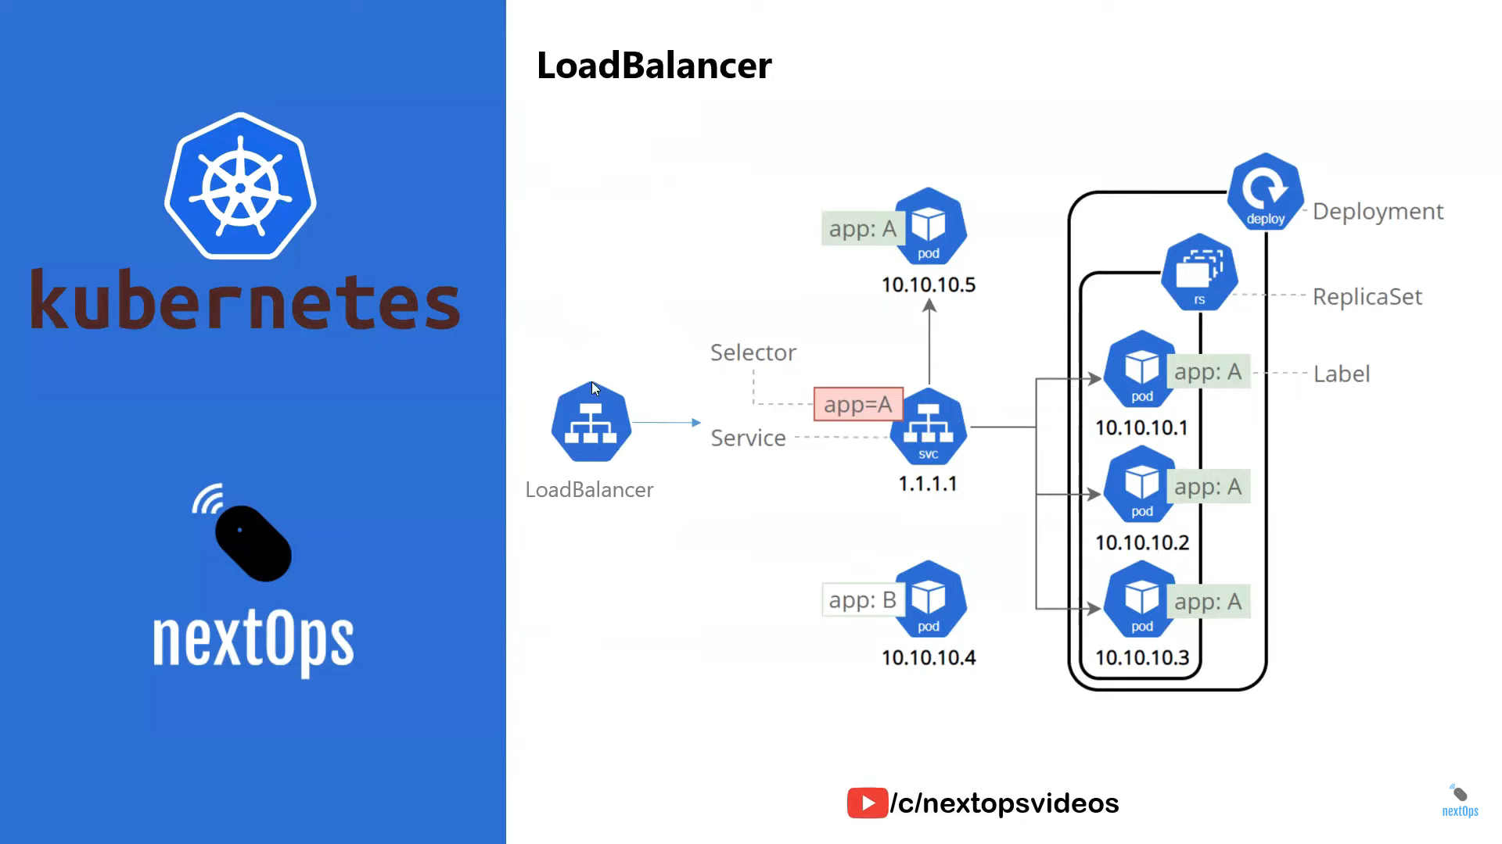

Slide 27
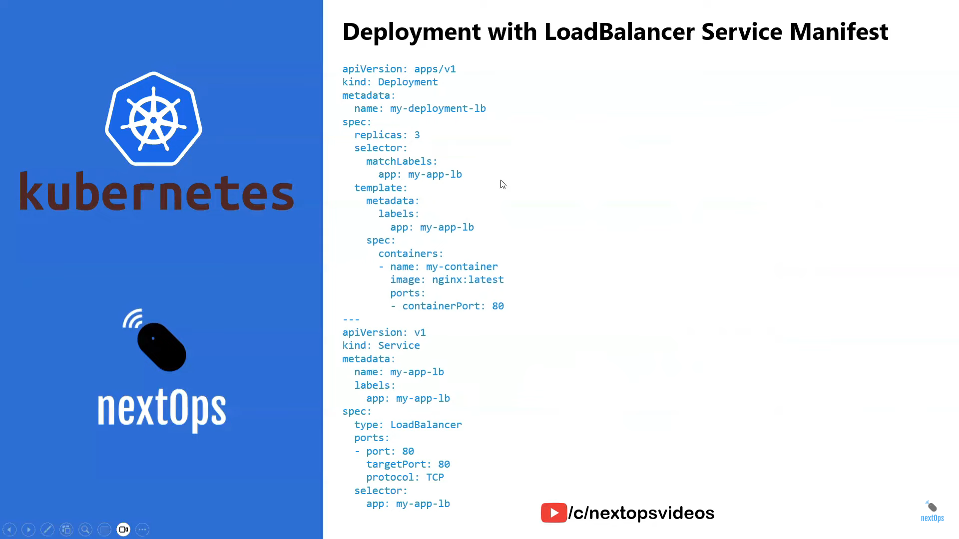

Slide 28
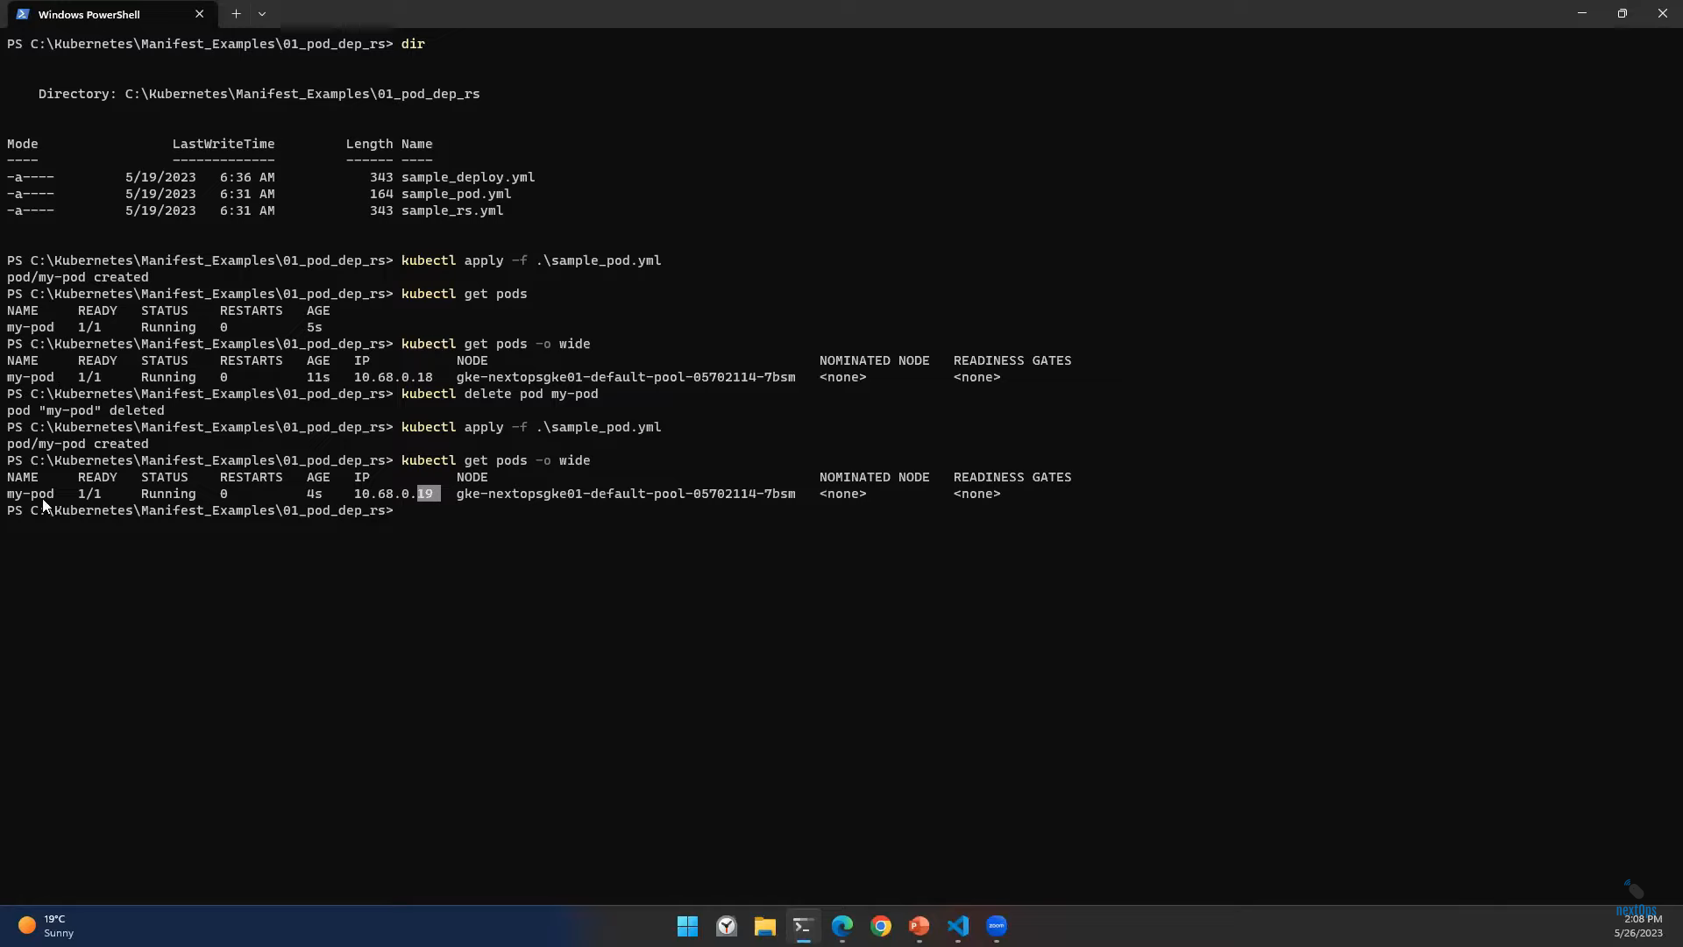




Whenever Pod got deleted and recreated a new IP will assign to the Pod

Slide 29
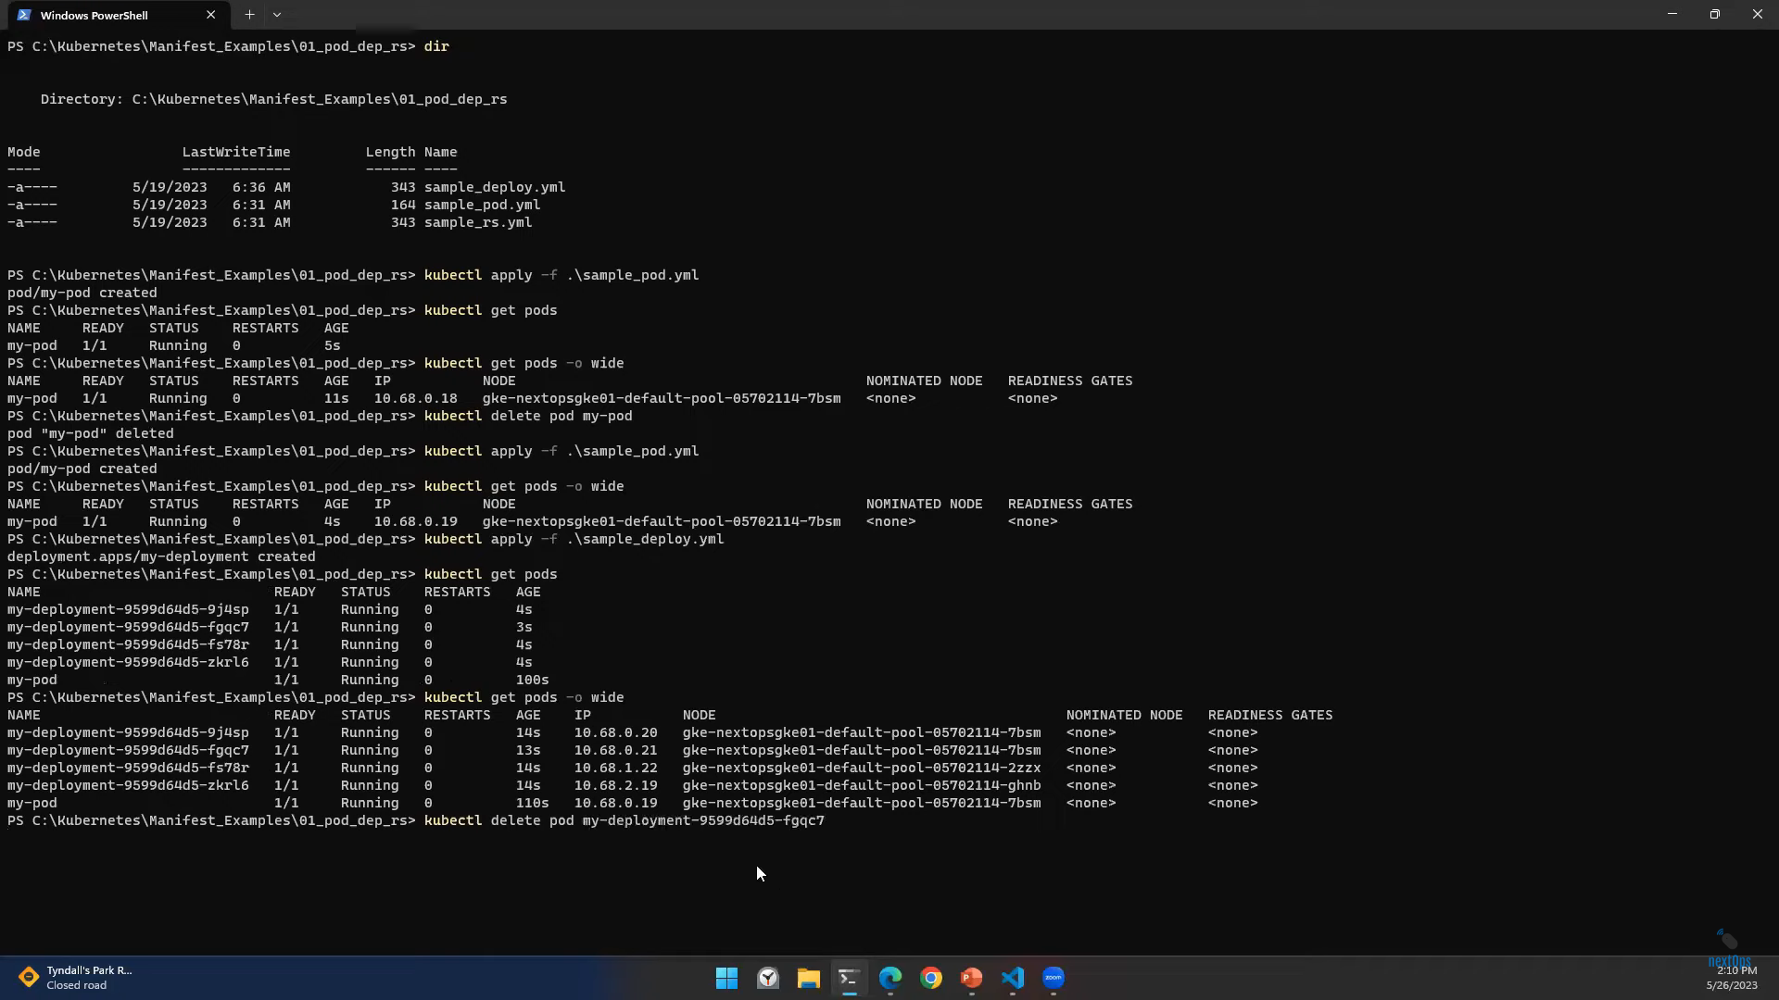

Slide 30
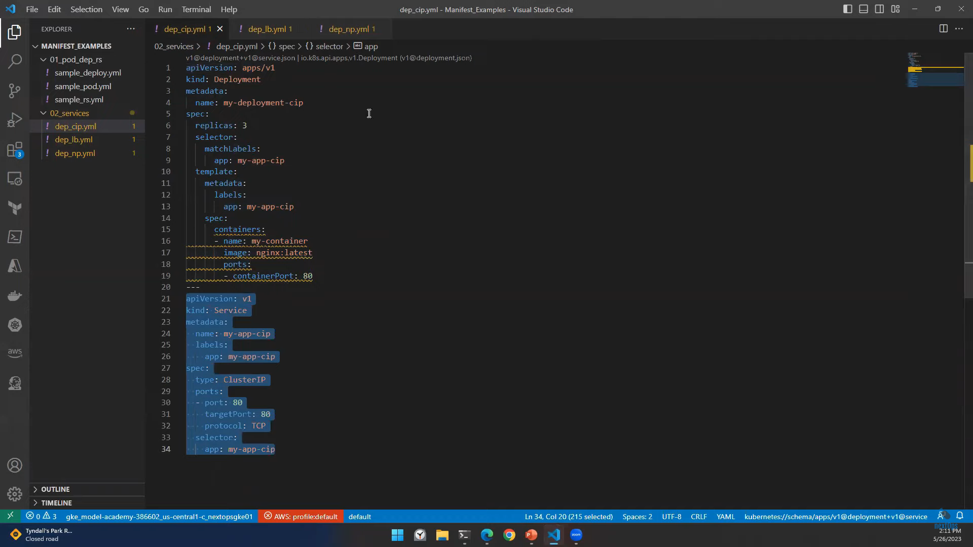

Slide 31
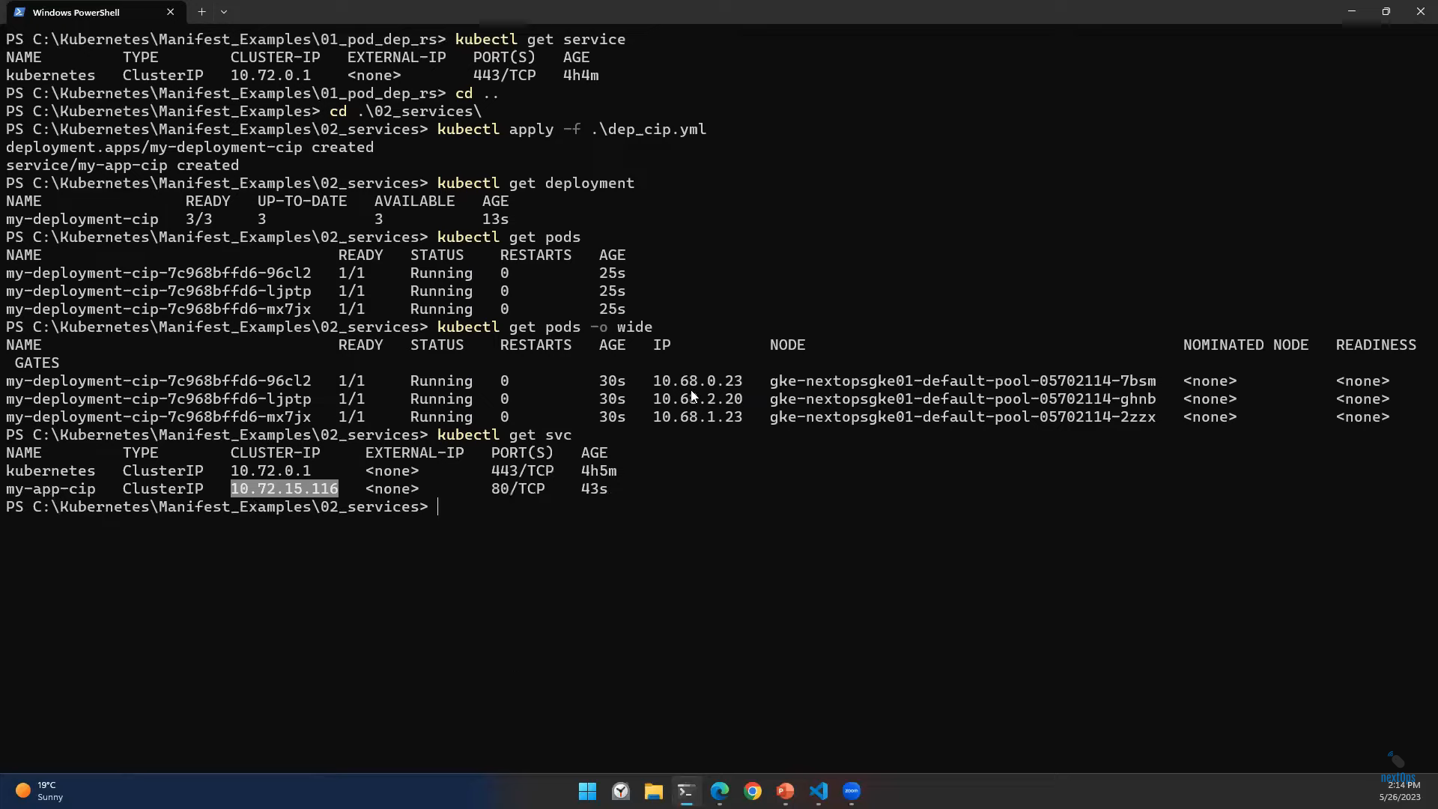




Traffic will come from ClusterIP and then it will go to Pod IP

Slide 32
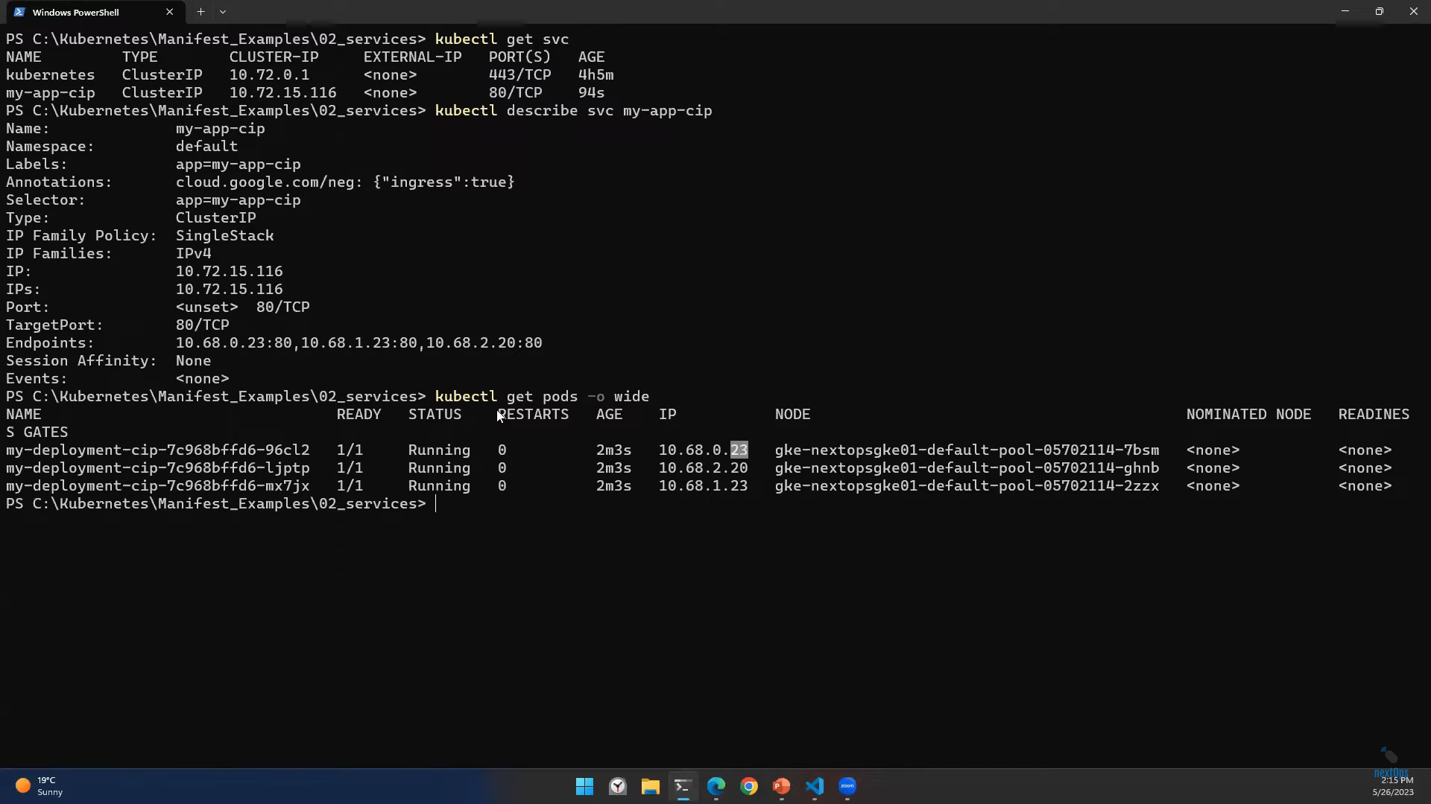






Private IP. Pods can access internally with this service only. We cannot access Externally
Pod IP’s

Slide 33
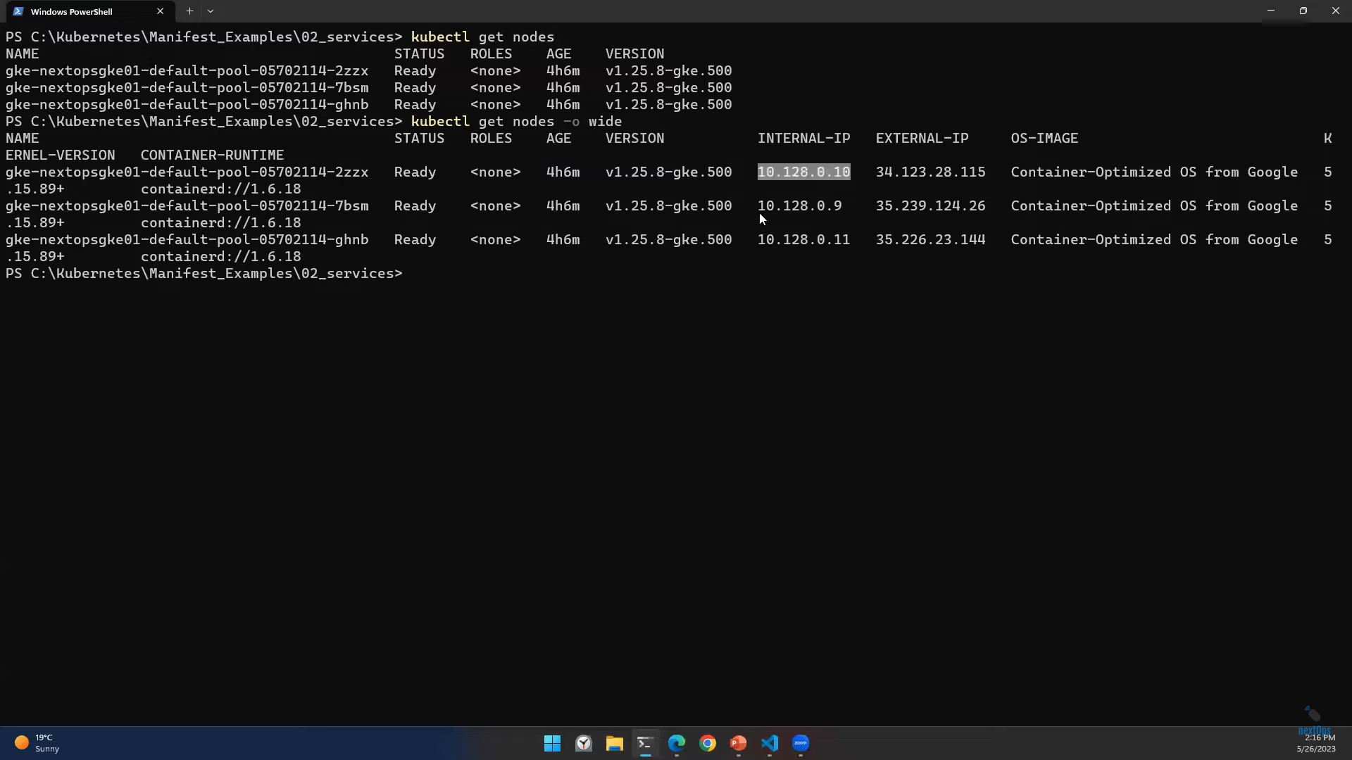


Slide 34
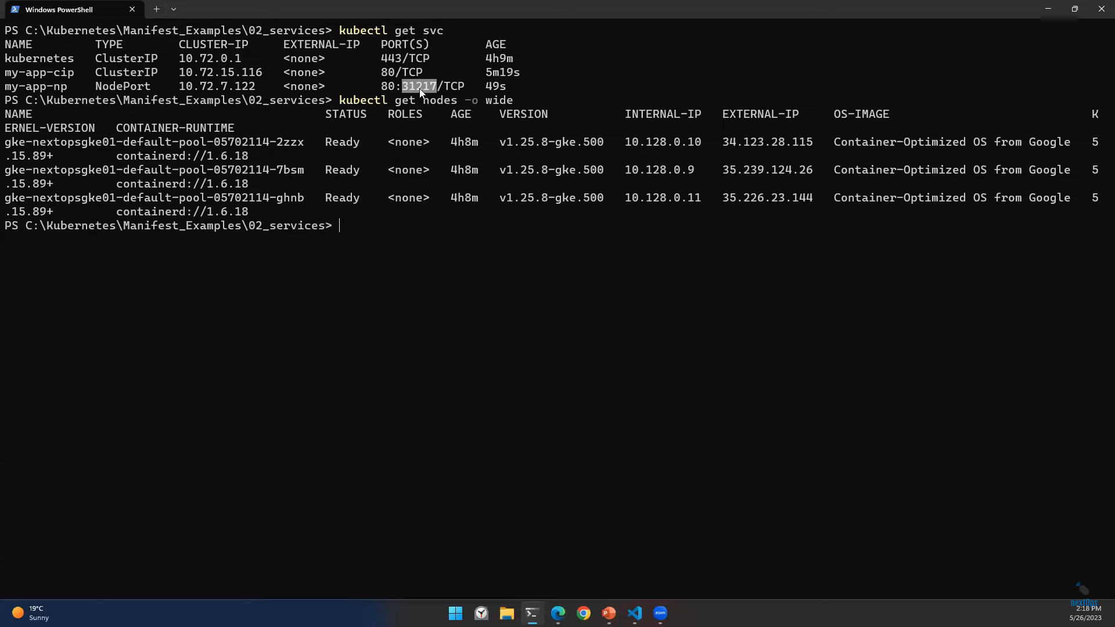




NodePort: 34.123.28.115:31217

Slide 35
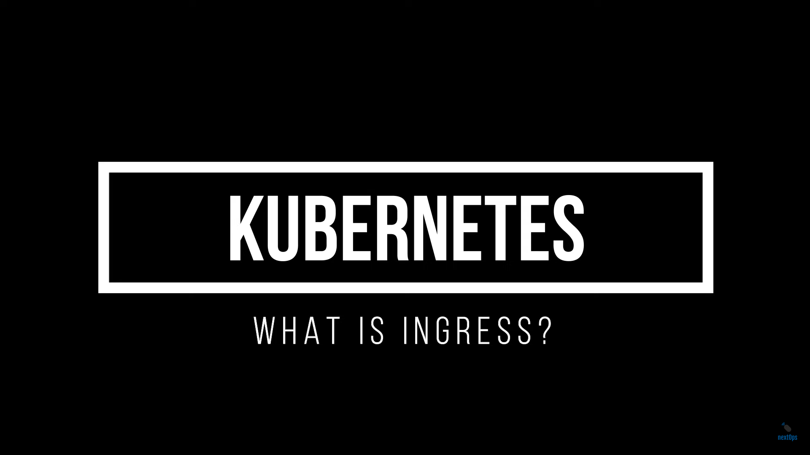

Slide 36
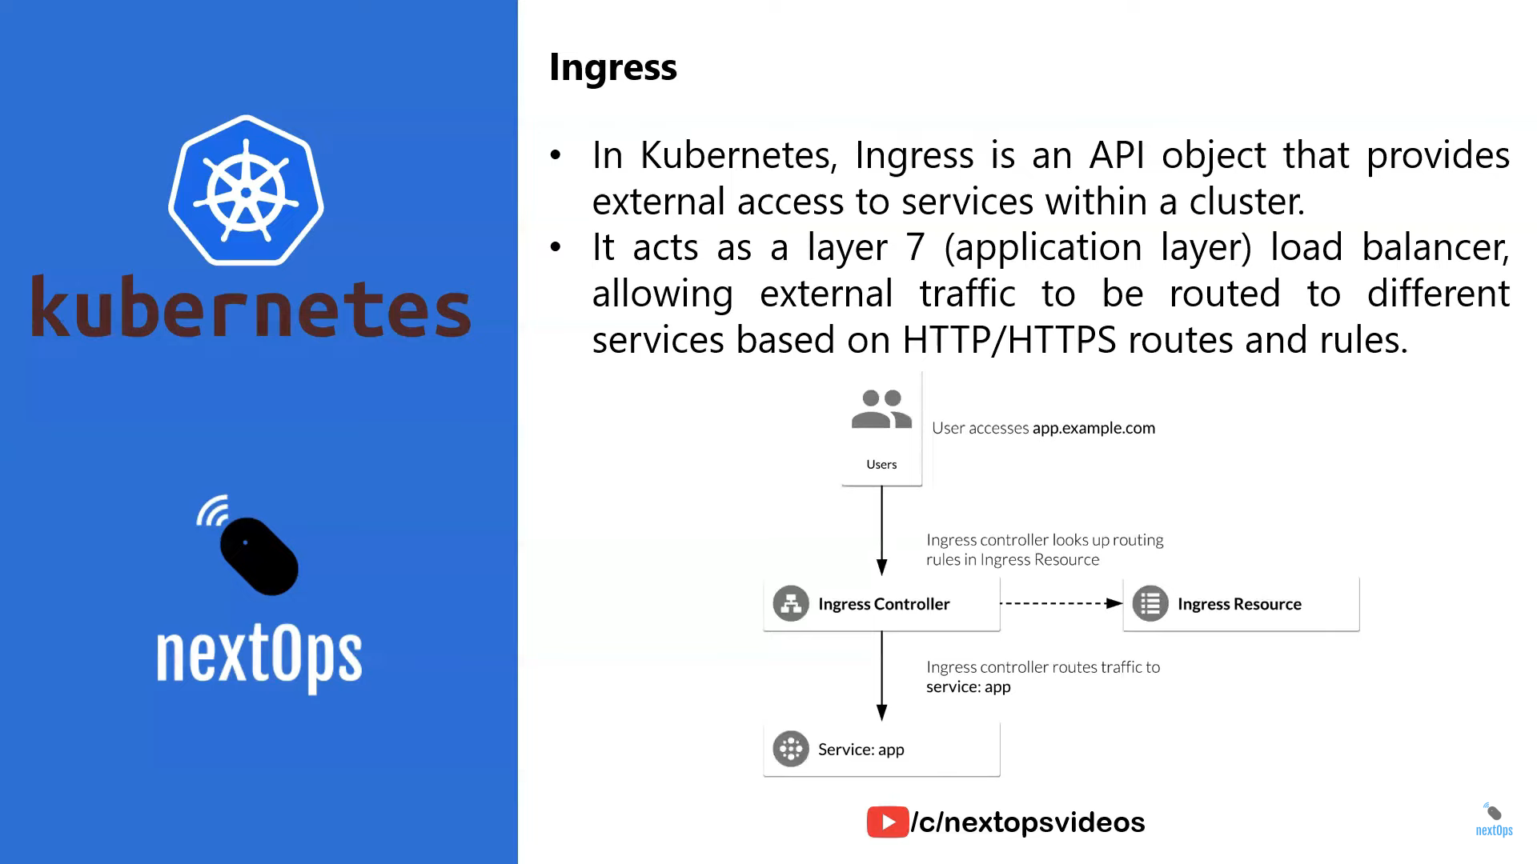

Slide 37
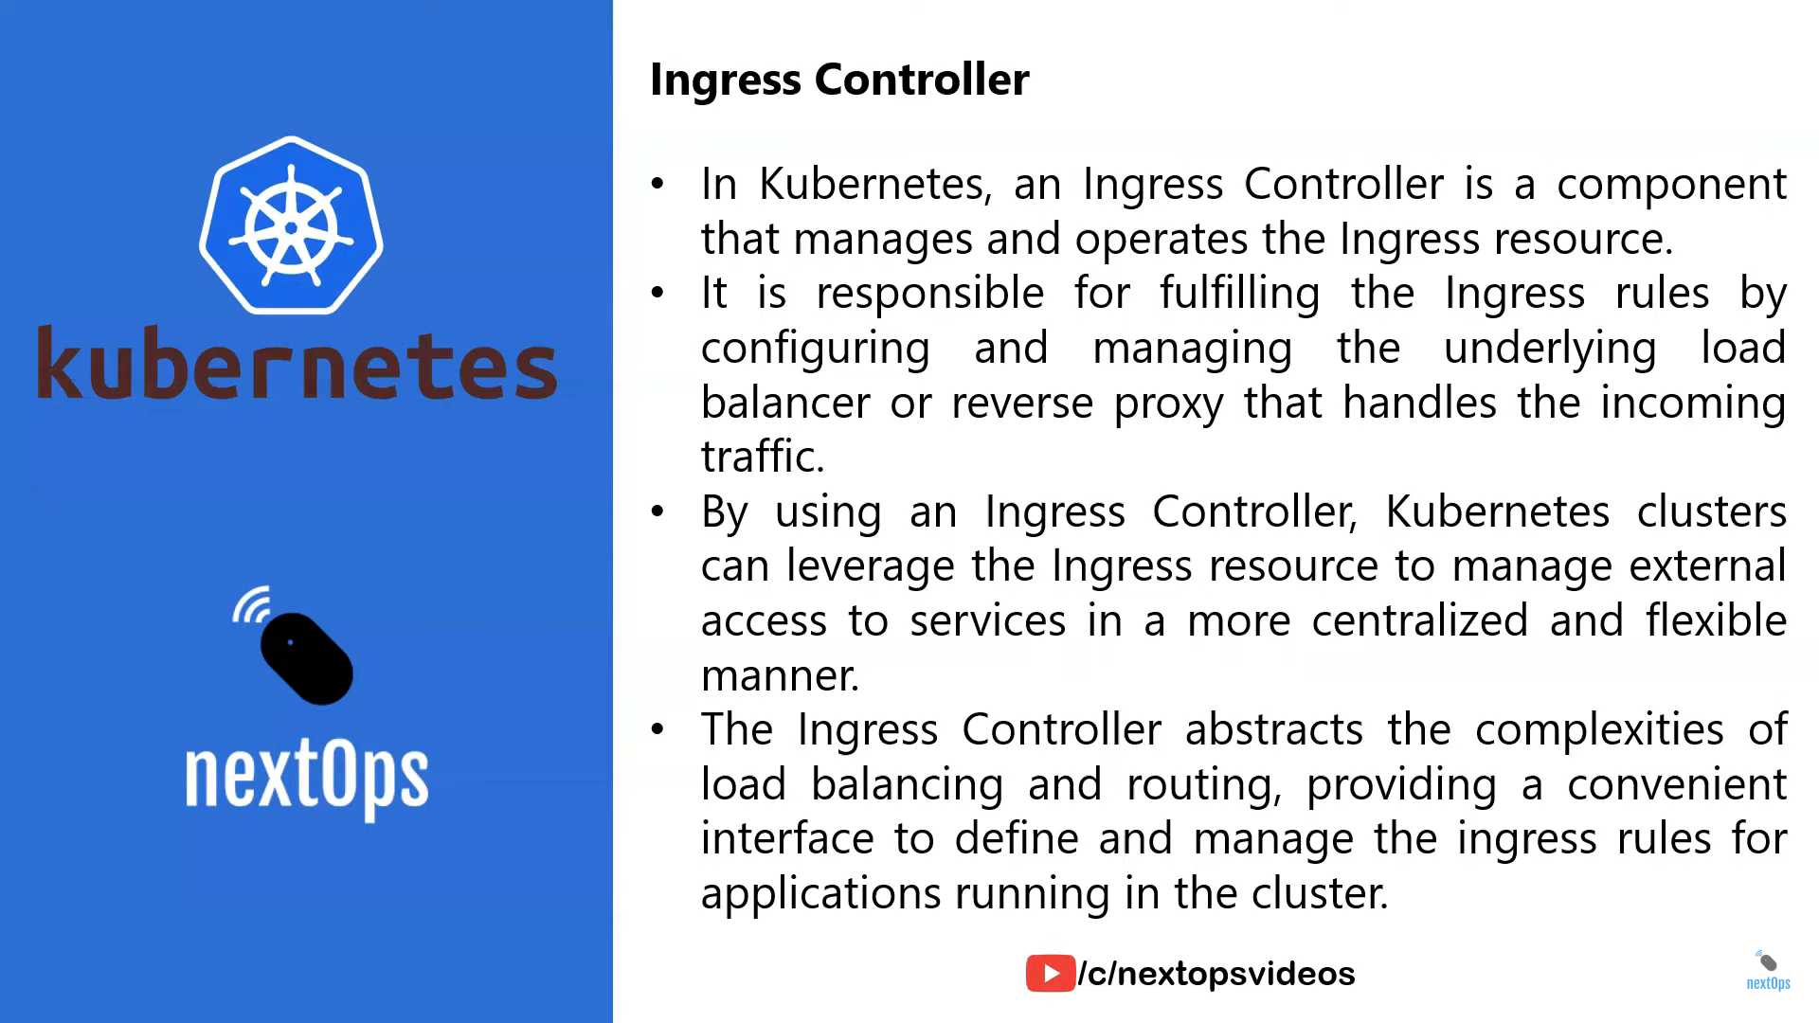

Slide 38
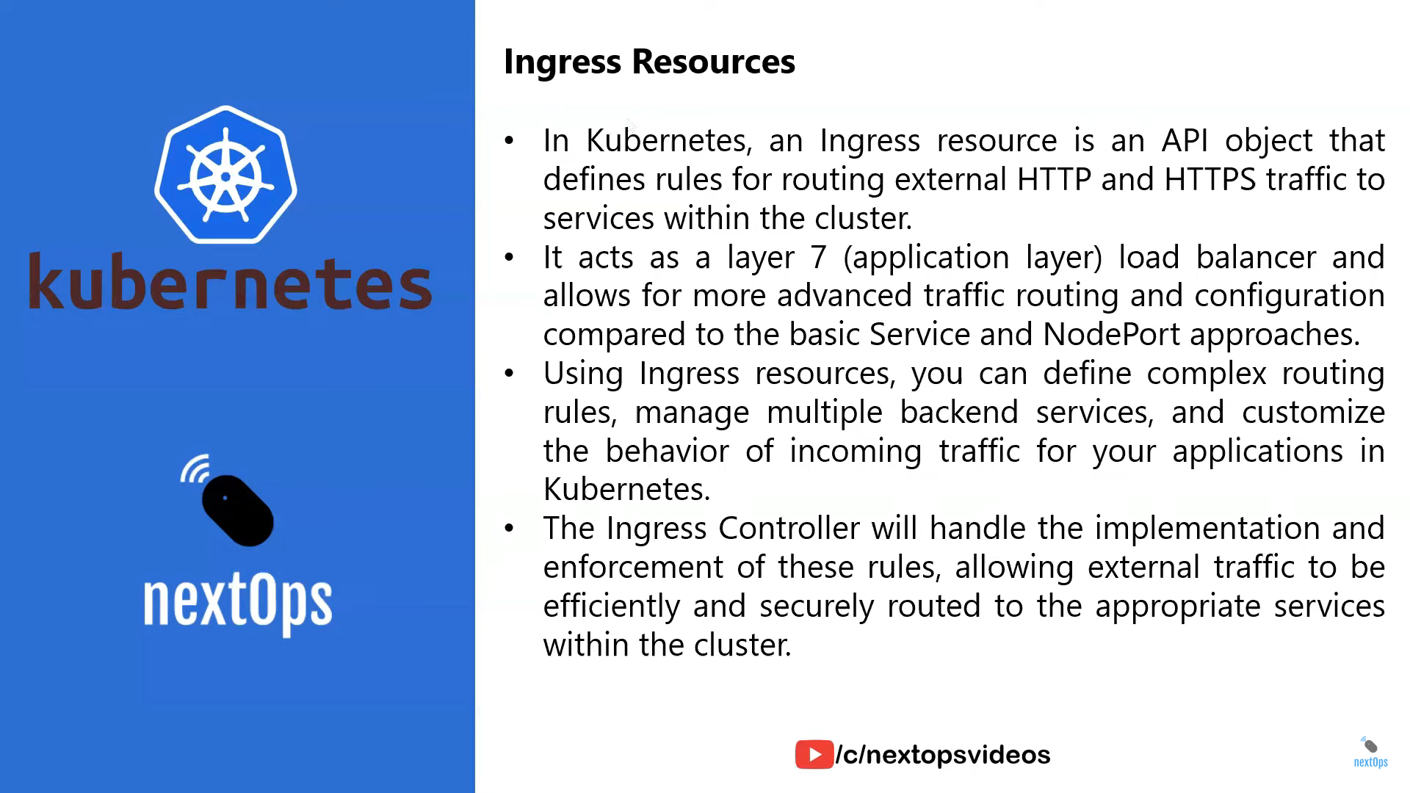

Slide 39
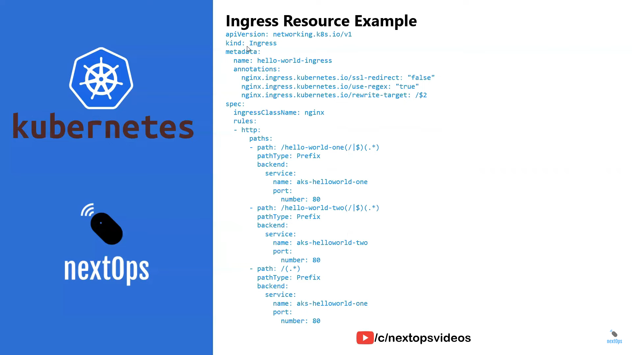
GitHub Repo: https://github.com/nextopsvideos/kubernetesyt.git

Slide 40
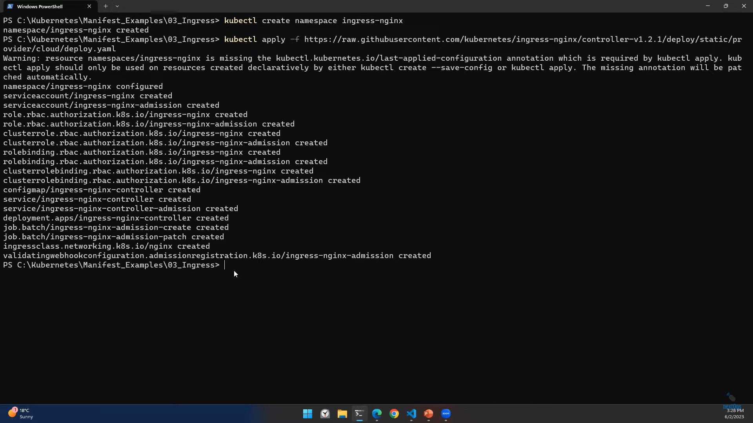
Installing ingress in k8s cluster by creating namespace initially
https://raw.githubusercontent.com/kubernetes/ingress-nginx/controller-v1.2.1/deploy/static/provider/cloud/deploy.yaml

Slide 41
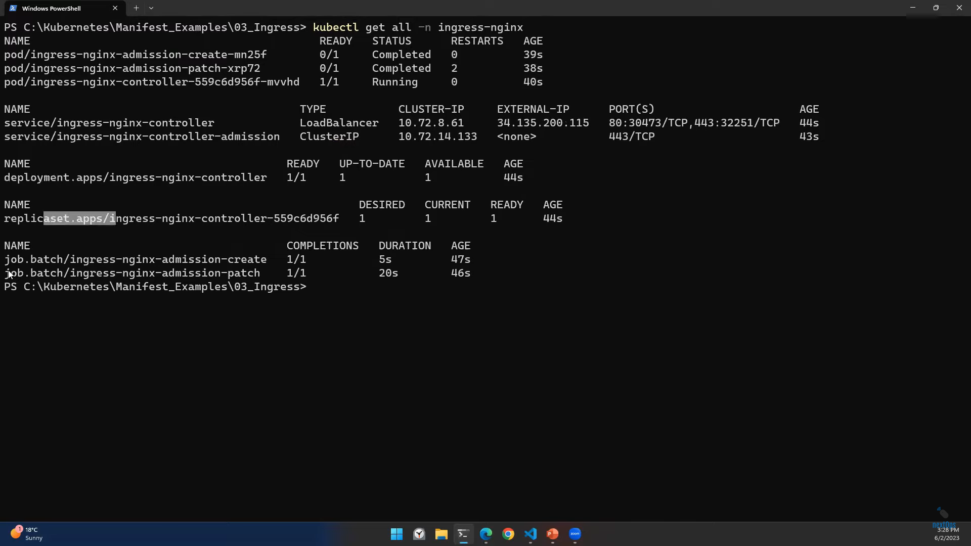
Installation of Ingress Controller has been completed

Slide 42
Now create two deployments and link those deployments in
Ingress manifest file.
In Ingress manifest file we can route based upon hostname or path-based routing for two applications(two deployments)

Slide 43
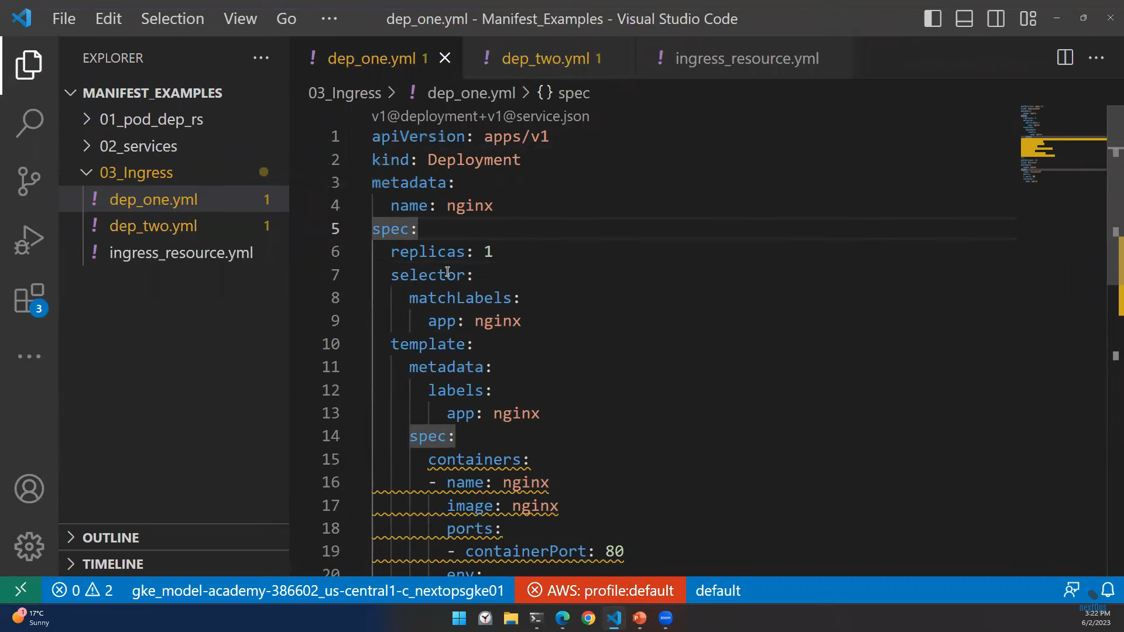
First Application

Slide 44
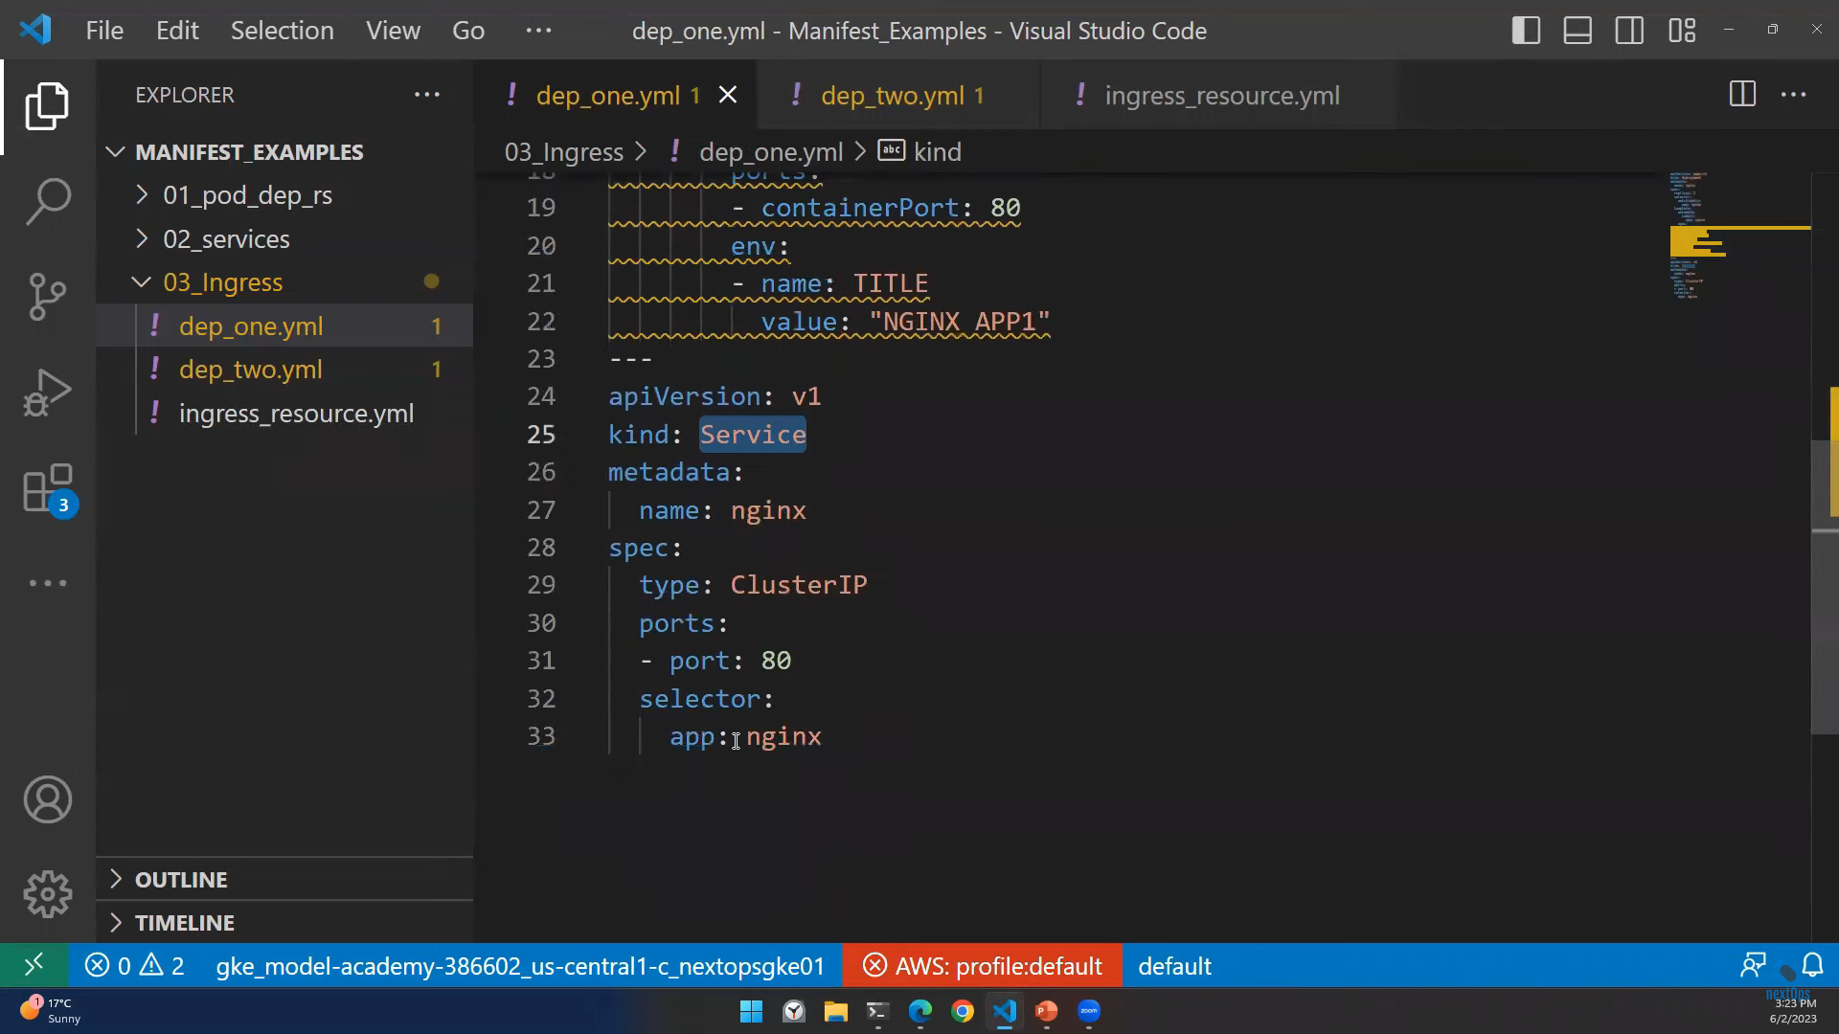

Slide 45
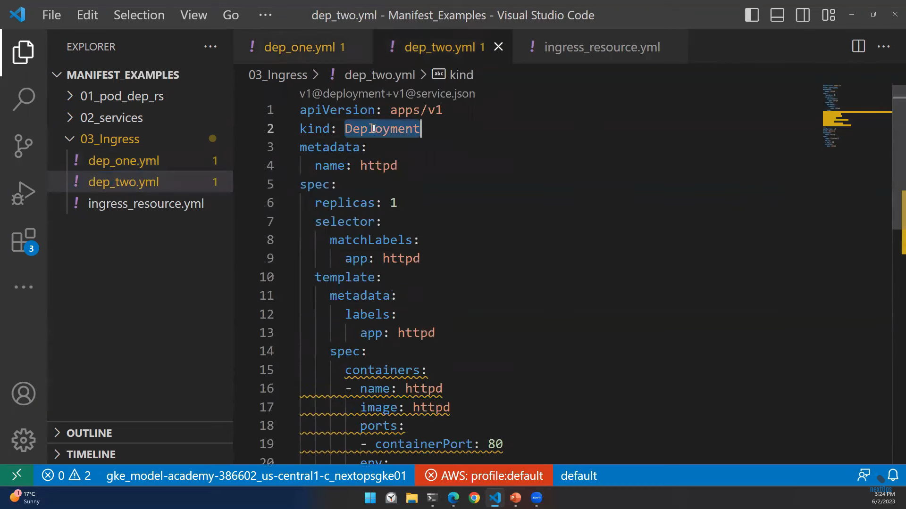
Second Application

Slide 46
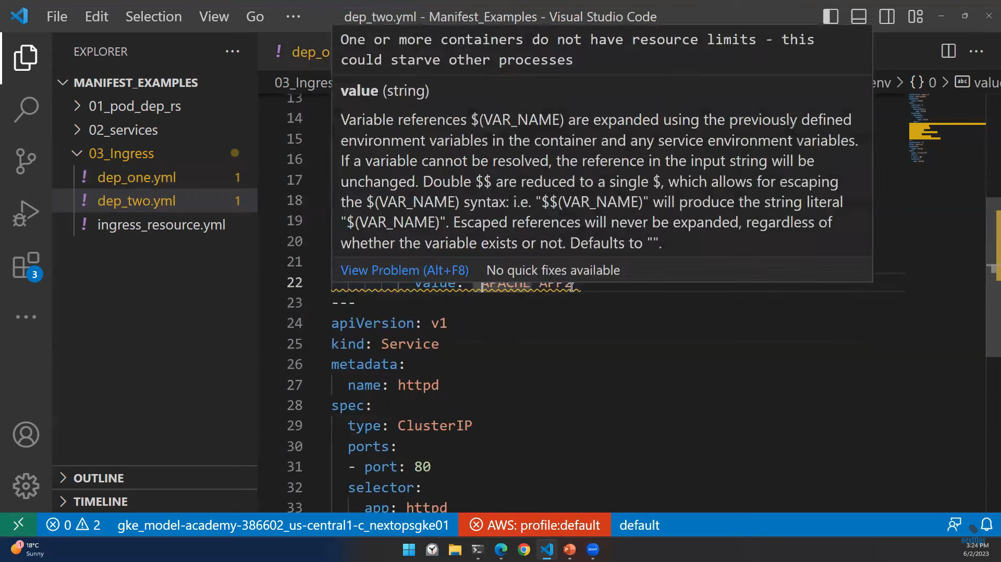

Slide 47
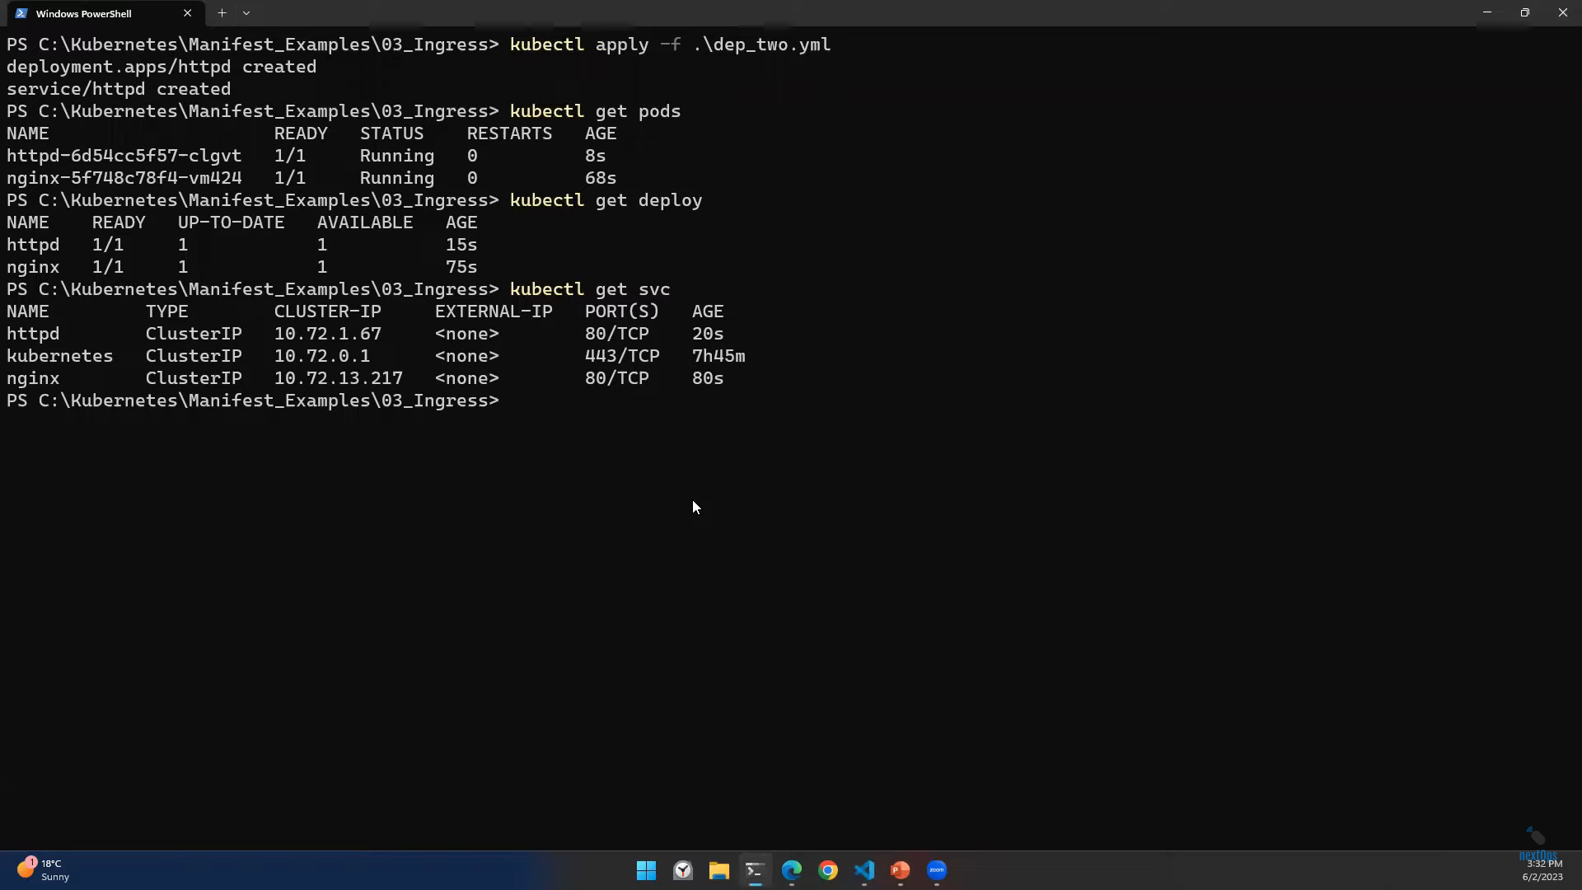
Now deploy two deployments. As per the terminal we can see we have ClusterIP for httpd and nginx. But we can Access this internally. Now we are linking the above two applications to the Ingress to provide traffic from externally and user can access both applications

Slide 48
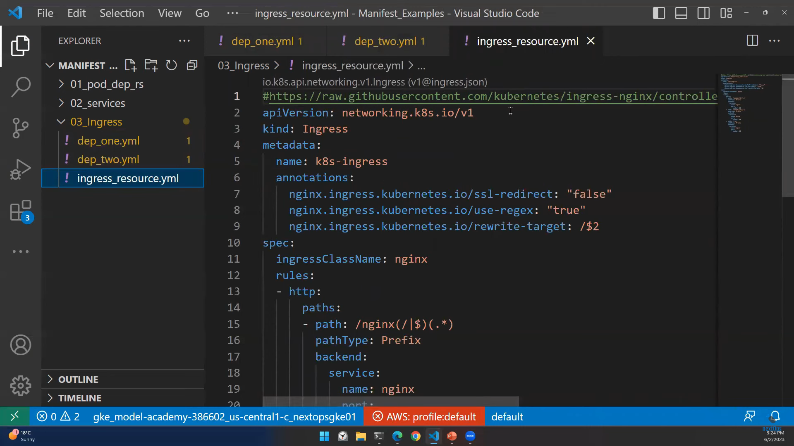
Ingress Manifest File

Slide 49
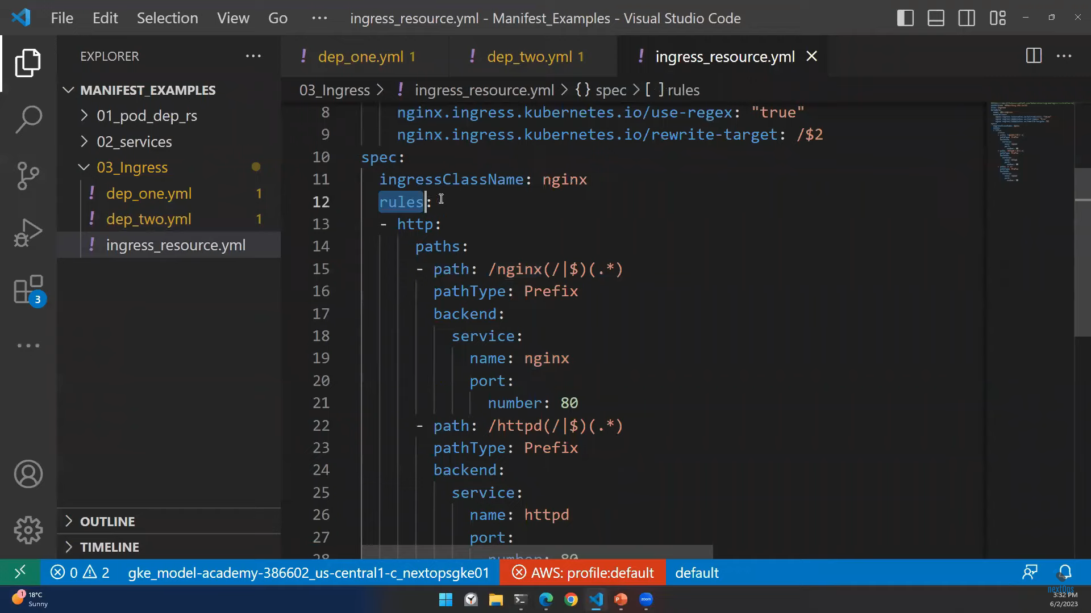

Slide 50
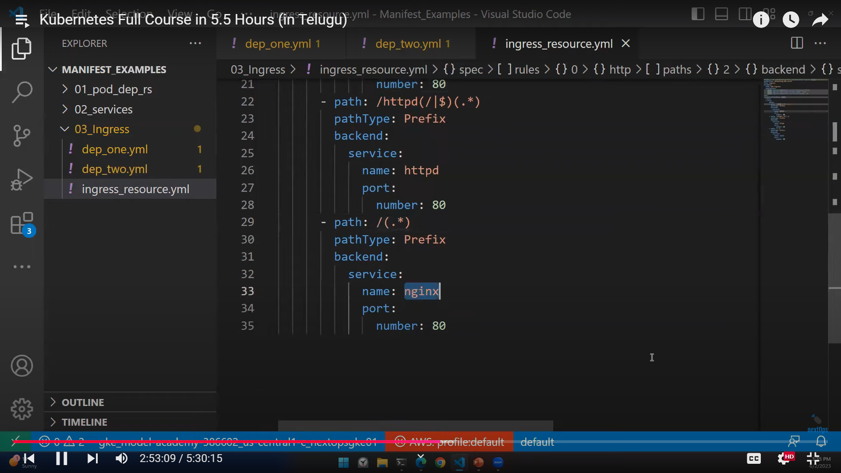

Slide 51
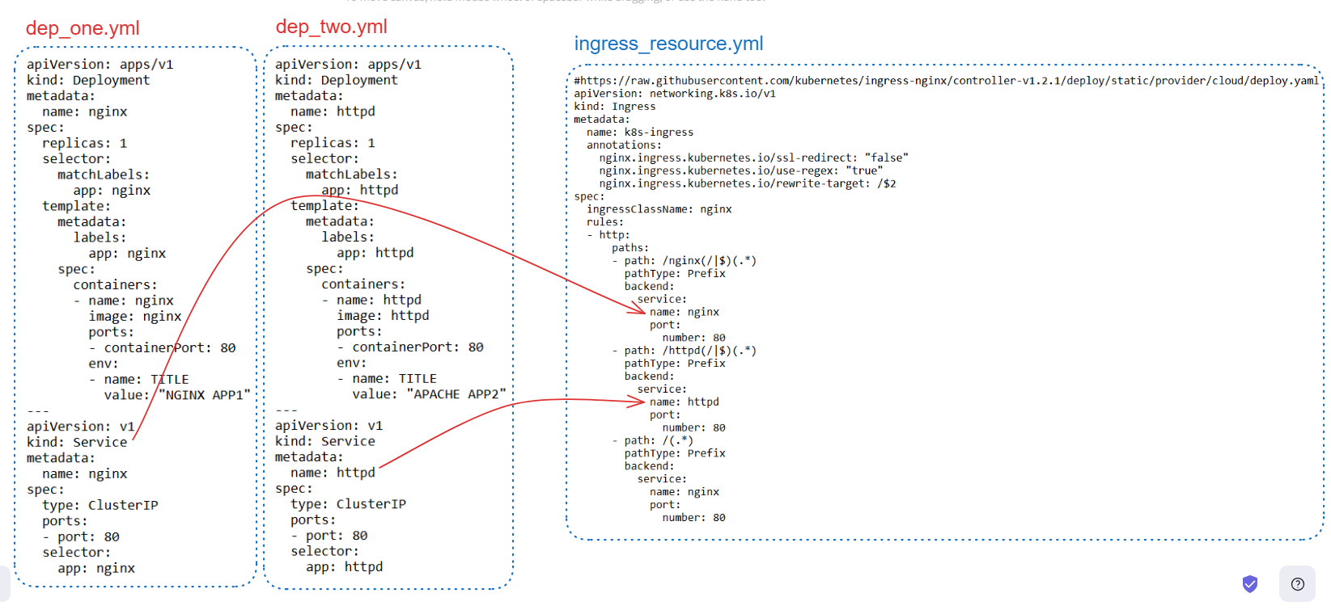

Slide 52
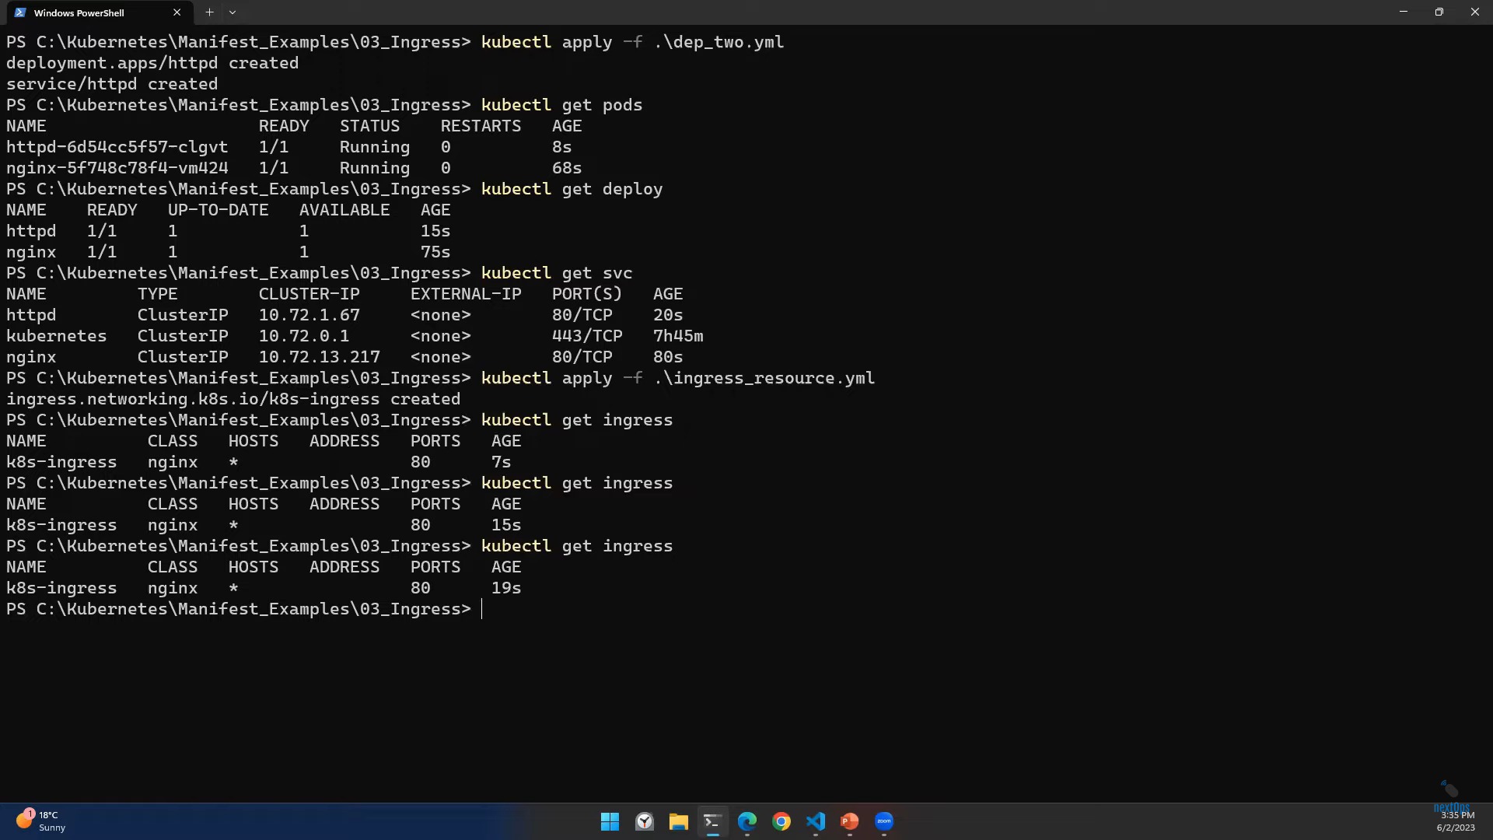
Now deploy ingress manifest file

Slide 53

Now we can access the application in path-based routings
34.135.200.115/nginx
34.135.200.115/httpd

Slide 54


Slide 55


Slide 56


Slide 57


Slide 58


Slide 59

echo –n ‘usernamemahesh’ > user.txt(dXN1cm5hbWU=)
echo –n ‘password’ > password.txt(cGFzc3dvcmq=)
How to encode data:
echo –n “secretpass” | base64
How to decode data
echo ‘csv43f4g3423v’ | base64 --decode

Slide 60

ls
To see environment variables

Slide 61


Slide 62

Deploying mongo-express image application

Slide 63

If we got any error please ignore. App has been deployed

Slide 64


Slide 65


Slide 66


Slide 67


Slide 68


Slide 69


Slide 70

We can create Database and we can see in the Graph

Slide 71


Slide 72


Slide 73


Slide 74


Slide 75

Namespaces related to cluster
Default namespaces

Slide 76

To see particular namespace objects

Slide 77


Slide 78

Setting custom namespace as a default
kubectl config set-context --current --namespace=default

Slide 79

Creating Pod in particular namespace

Slide 80


Slide 81


Slide 82


Slide 83


Slide 84


Slide 85


Slide 86


Slide 87


Slide 88


Slide 89


Slide 90


Slide 91


Slide 92


Slide 93


Slide 94



Created disk by created pv (persistent volume)

Slide 95


Changing Reclamation Policy

Slide 96


Slide 97



If pod deletes volume also deletes
If pod deletes then volume retains(It wont delete)

Slide 98


Slide 99



Slide 100


When we describe our Pod

Slide 101

As we can see the status of PV and So, we can see it is on Bound status. So, we have Retain policy. So, after deleting the
Pod also we have pv and pvc in bound status. Both pv and pvc are working together

Slide 102


Scenario if retain policy is deleted
In this scenario if pod deleted the volume
attached to the pod also deletes
Little bit confusion in this.
Please see later

Slide 105


Slide 106


Slide 107


Slide 108


Slide 109


Slide 110


Slide 111


Slide 112


Slide 113


Slide 114


Slide 115


Slide 116


Slide 117


Slide 118


Slide 119


Slide 120


Slide 121


Slide 122


Slide 123


Slide 124


Slide 125


Slide 126


In this Job will create one Pod and it will complete the task. Once it was completed the status is completed
and exits out

Slide 127


Slide 128


Kubectl get all –n kube-system By default we will get metric server

Slide 129

Minimum resource quota
Maximum resource quota
Minimum resource quota
Maximum resource quota
This is just an example

Slide 130


Slide 131


Slide 132


First deploy deployment and then after deploy HPA
As per the left box this HPA will scale in and scale out
The Pods

Slide 133



Whenever pod reaches 50% consumption it will create more pods
Based upon the utilization

Slide 134


Slide 135


Slide 136


Slide 137


Slide 138


Slide 139


100 Micro CPU’s
200 MB

Slide 140

IMP
If we mention the limit range in the particular namespace then pods which are going to create in that particular namespace would be in the limit.
If we don’t mention any namespace, it will take default.
In deployment we should mention the limits as optional
If we need limits for the pods

Slide 141


Slide 142


Slide 143


Slide 144


Slide 145



